Slide 1

Fact - Myth - Fallacy
Compilation of Slides

Slide 2
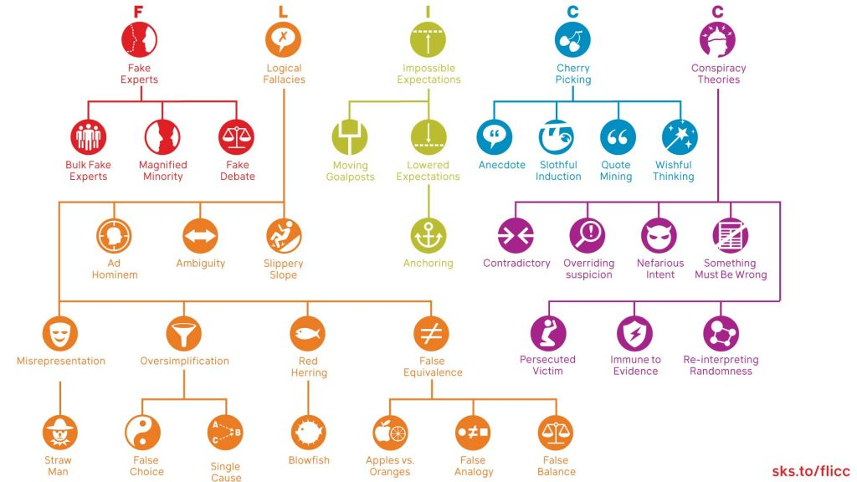

The FLICC Techniques of Science Denial

Slide 3
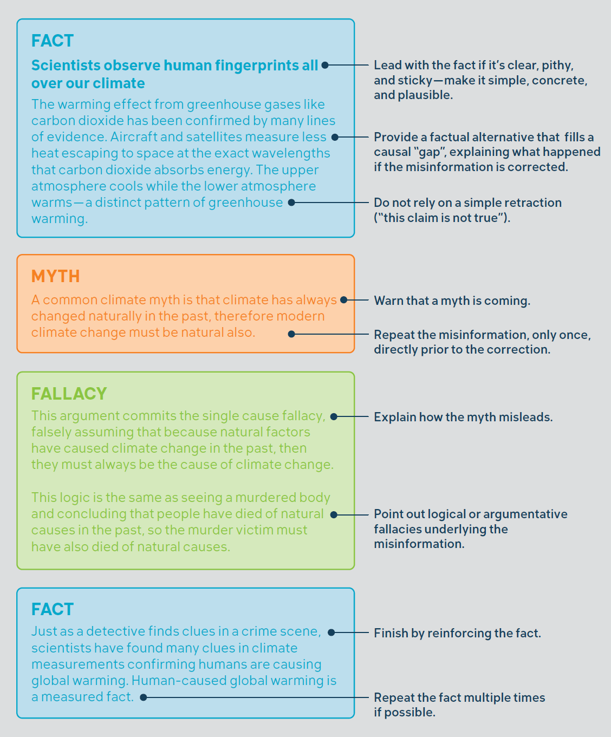
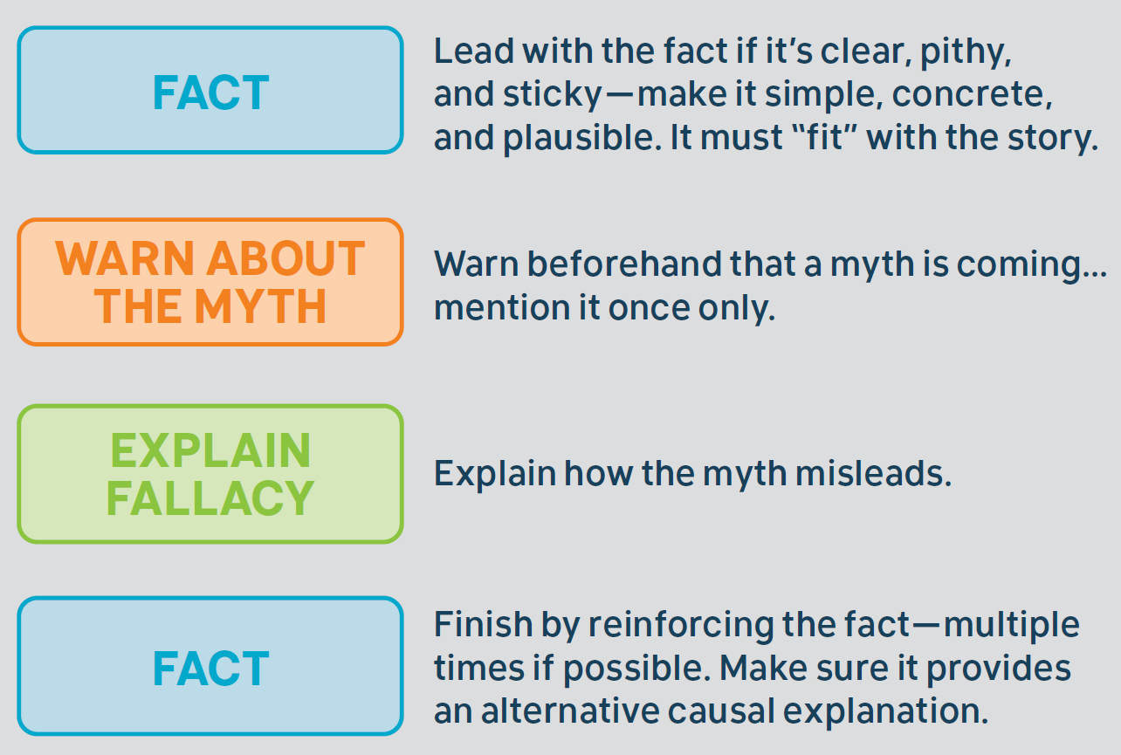
Components of
successful debunking

Slide 4
Some notes about this slide-deck
The code words on the index page are from here: https://skepticalscience.com/shorturls.php
The shown graphics are just suggestions –
there may be better ones to suit your purposes
The Fact-Myth-Fallacy texts are just very short explanations
Please use the URL shown at the bottom right of each slide for longer explanations

Slide 5
Global Warming is happening
1998
Cold
Glacier
Greenland
Antarctica
Temp
UHI
Winter
Name
We are causing Global Warming
CO₂
Volcano
Residence
Thermo
Saturate
Lag
Hotspot
Trace
Sun
Consensus
Past and future climate change
Past
LIA
Past CO₂
MWP
Model
Hansen1988
Weather
1970s
Iceage
Climate change impacts
Vapor
Cloud
Species
Bear
Acid
Impacts
Pollutant
Plant
Extreme

Slide 6
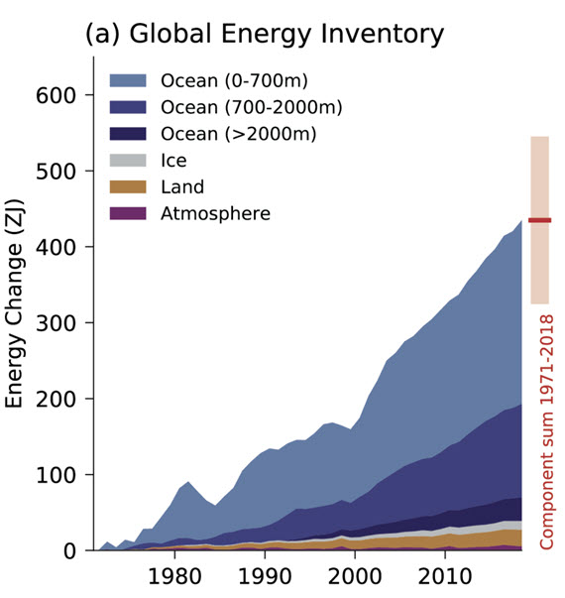


Global Warming is happening
FACT
Our planet has continued to build up heat since 1998 - global warming is still happening.
MYTH
Global warming stopped in 1998.
FALLACY
Looking at one region or a short period ignores the full picture.
Source: Cross-Chapter Box 9.1 Figure 1 (part a) IPCC AR6 WGI Chapter 9.
Cherry-
picking
http://sks.to/1998

Slide 7
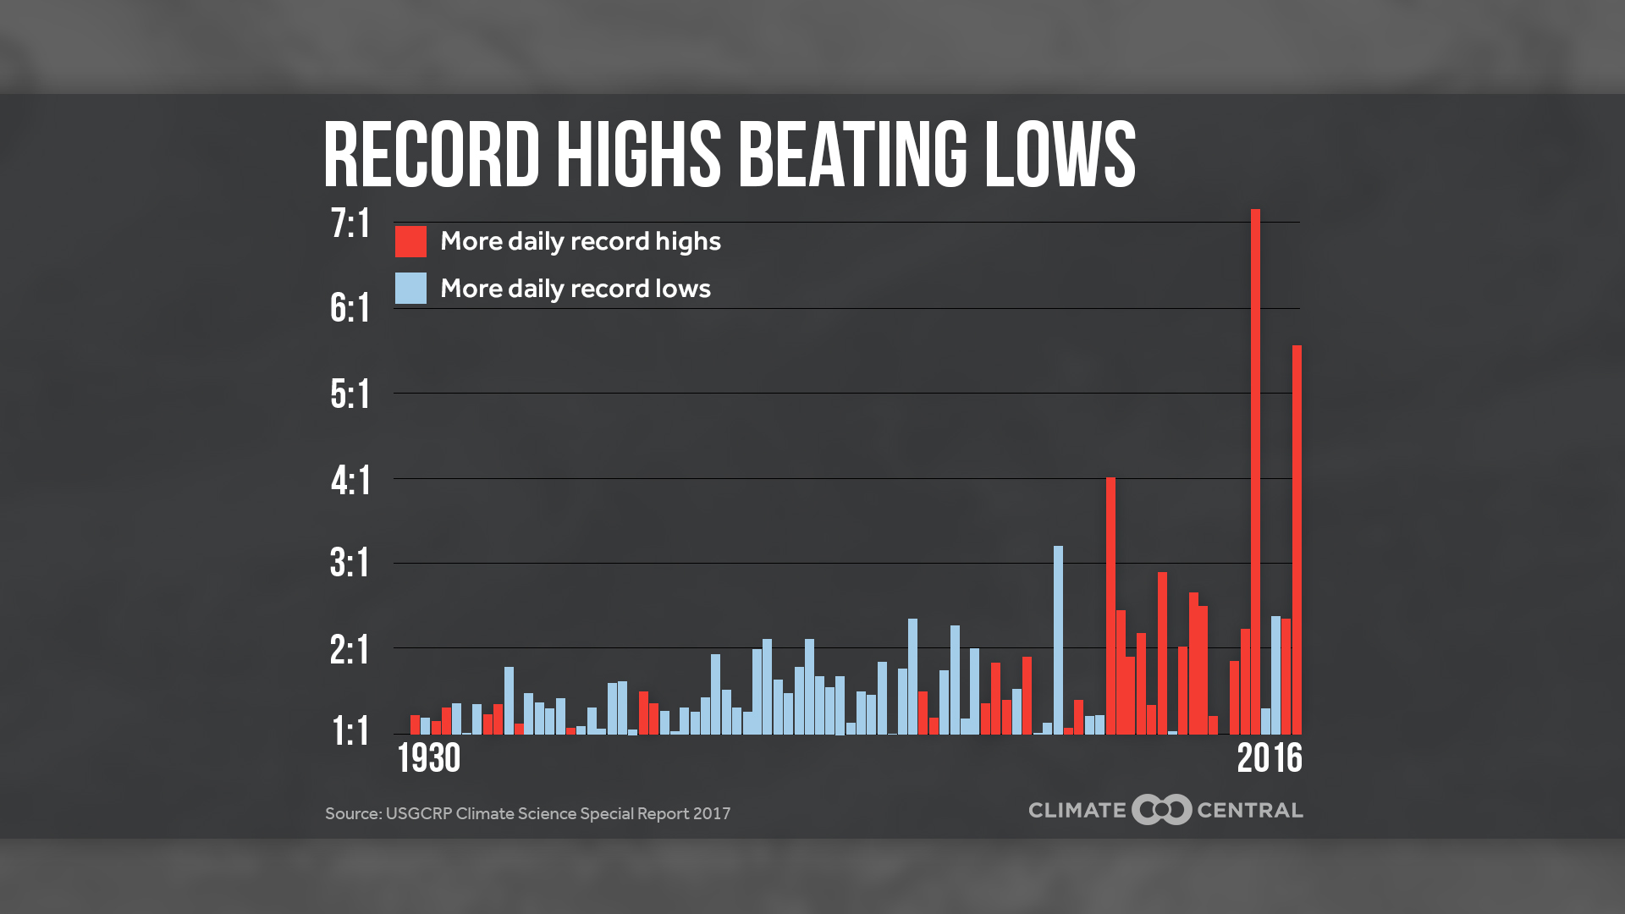

Global Warming is happening
FACT
Global warming is like rigging the weather dice, making it more likely to get hot days.
MYTH
It's cold outside, so global warming must have stopped.
FALLACY
Global warming doesn't mean no more cold weather, just fewer cold days compared to hot days.
Climate Central - http://www.climatecentral.org/gallery/graphics/daily-record-highs-are-dramatically-outpacing-daily-record-lows
Impossible
Expectations
http://sks.to/cold

Slide 8
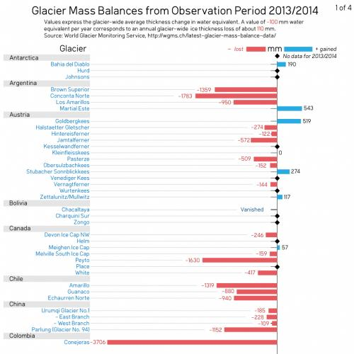
Global Warming is happening
FACT
Overall, glaciers across the globe are shrinking at an accelerating rate, threatening water supplies for millions of people.
MYTH
Glaciers around the world are increasing, disproving global warming.
FALLACY
Picking a handful of growing glaciers ignores the vast majority of glaciers that are shrinking.
Cherry-
picking
Skeptical Science - https://skepticalscience.com/graphics.php?g=246
http://sks.to/glacier
Skeptical Science - https://skepticalscience.com/graphics.php?g=246

Slide 9
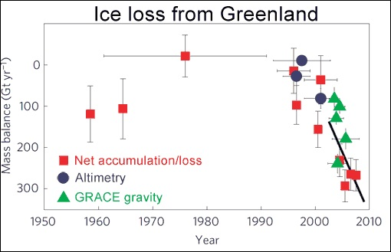
Global Warming is happening
FACT
Greenland on the whole is losing ice, at a rate of over 2 Mount Everests worth of ice every year.
MYTH
Greenland ice sheet is thick- ening in the middle so it must be gaining mass.
FALLACY
Looking at the whole ice sheet shows it's thickening in the middle but ice loss at the edges is accelerating.
Estimated Greenland Ice Sheet mass balance changes since 1950 using three different methods (Jiang 2010)
Cherry-
picking
http://sks.to/greenland

Slide 10
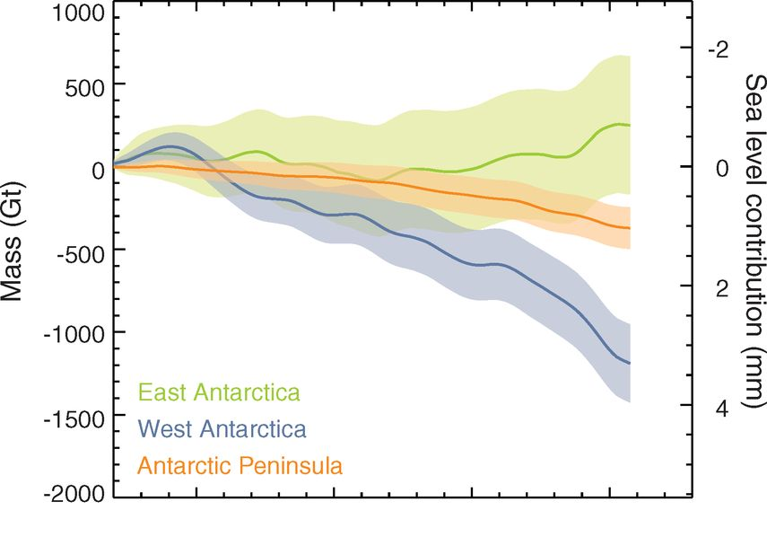


Global Warming is happening
FACT
The West Antarctic ice sheet is losing hundreds of billions of tonnes of ice every year, making it a major contributor to global sea level rise.
MYTH
Antarctic sea ice is on the increase and casts doubt on global warming.
FALLACY
A number of factors may contribute to the increase in sea ice - but in no way does it change the fact that climate change is happening.
Estimates of total Antarctic land ice changes and approximate sea level contributions using a combination of different measurement techniques (Shepherd, 2012).
Over-
simplification
http://sks.to/antarctica

Slide 11
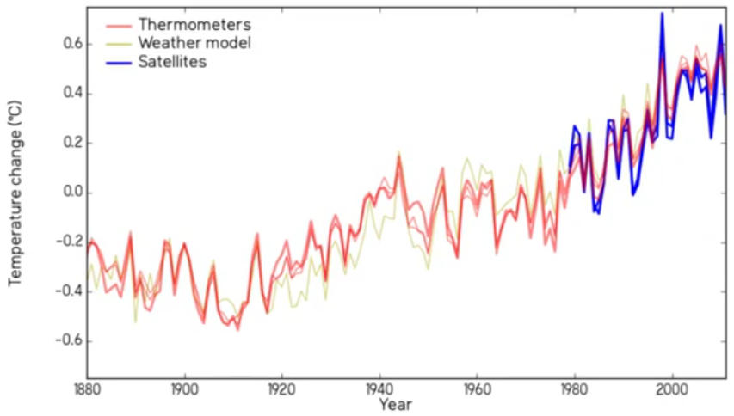

Global Warming is happening
FACT
We can measure temperature in many ways and they all say the same thing - our planet is warming.
MYTH
The thermometer record is unreliable.
FALLACY
Just because measurements have uncertainties doesn't mean it's unknowable. The uncertainty is smaller than measured global warming. The ambiguity of the term “uncertainty” is exploited.
Denial101x - 2.4.1. - https://youtu.be/YKQiyBkt4Vs
Ambiguity
http://sks.to/temp

Slide 12
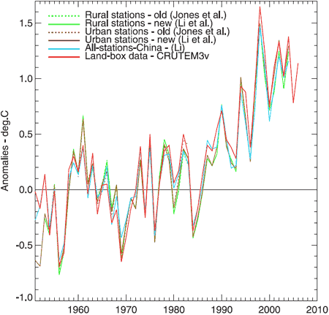

Global Warming is happening
FACT
Urban heat has had minimal effect on the climate record, with much warming happening where there is little urban development.
MYTH
Urban development is responsible for much of global warming over the last century.
FALLACY
Just because urban heat might affect the climate record doesn't mean it does. Scientists have confirmed it has negligible effect.
Misrepre-sentation
http://sks.to/uhi

Slide 13
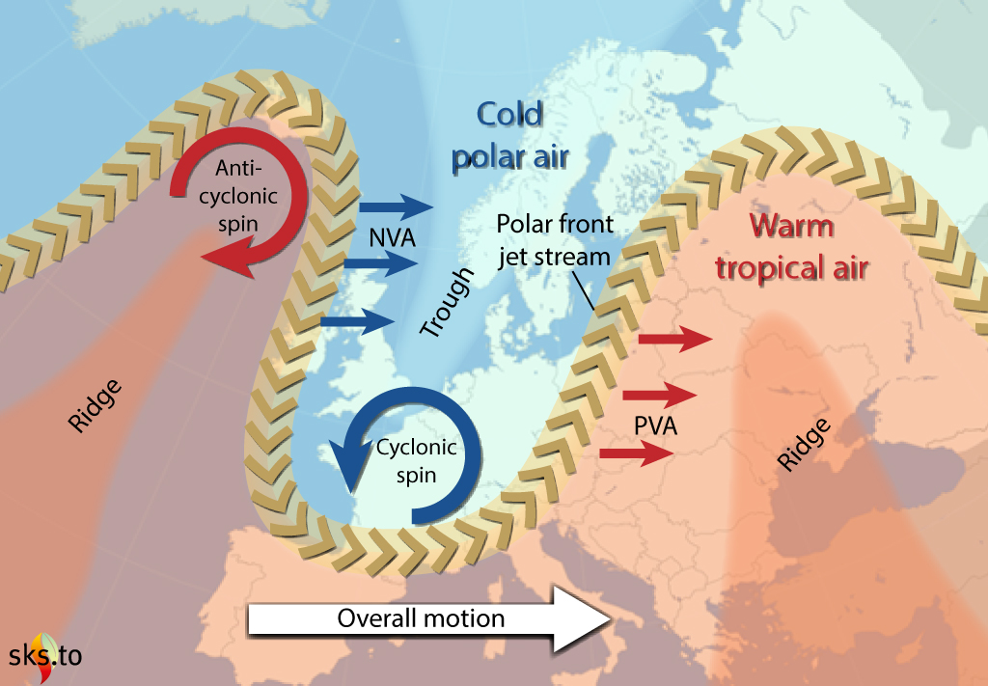
Global Warming is happening
FACT
Slowing jet stream is causing Arctic cold air to leak down into Europe and North America, like an open fridge leaking cold air into the kitchen.
MYTH
Record cold winters disprove global warming.
FALLACY
A cold winter doesn't disprove global warming, you need to look at the big picture.
Skeptical Science: https://skepticalscience.com/graphics.php?g=98
Impossible Expectations
http://sks.to/winter

Slide 14
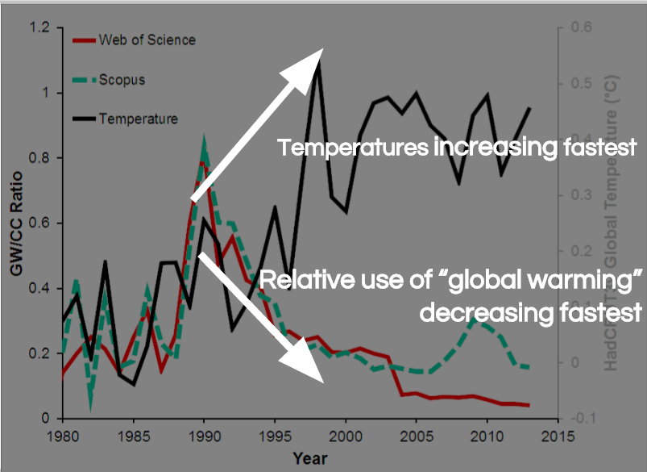
Global Warming is happening
FACT
Climate change and global warming have both been used for decades.
MYTH
They changed name from ‘global warming’ to ‘climate change’.
FALLACY
They didn't change the name (let alone in connection with temperature changes!)
Denial101x – 2.4.4.1
Misrepre-
sentation
http://sks.to/name

Slide 15
Global Warming is happening
1998
Cold
Glacier
Greenland
Antarctica
Temp
UHI
Winter
Name
We are causing Global Warming
CO₂
Volcano
Residence
Thermo
Saturate
Lag
Hotspot
Trace
Sun
Consensus
Past and future climate change
Past
LIA
Past CO₂
MWP
Model
Hansen1988
Weather
1970s
Iceage
Climate change impacts
Vapor
Cloud
Species
Bear
Acid
Impacts
Pollutant
Plant
Extreme

Slide 16
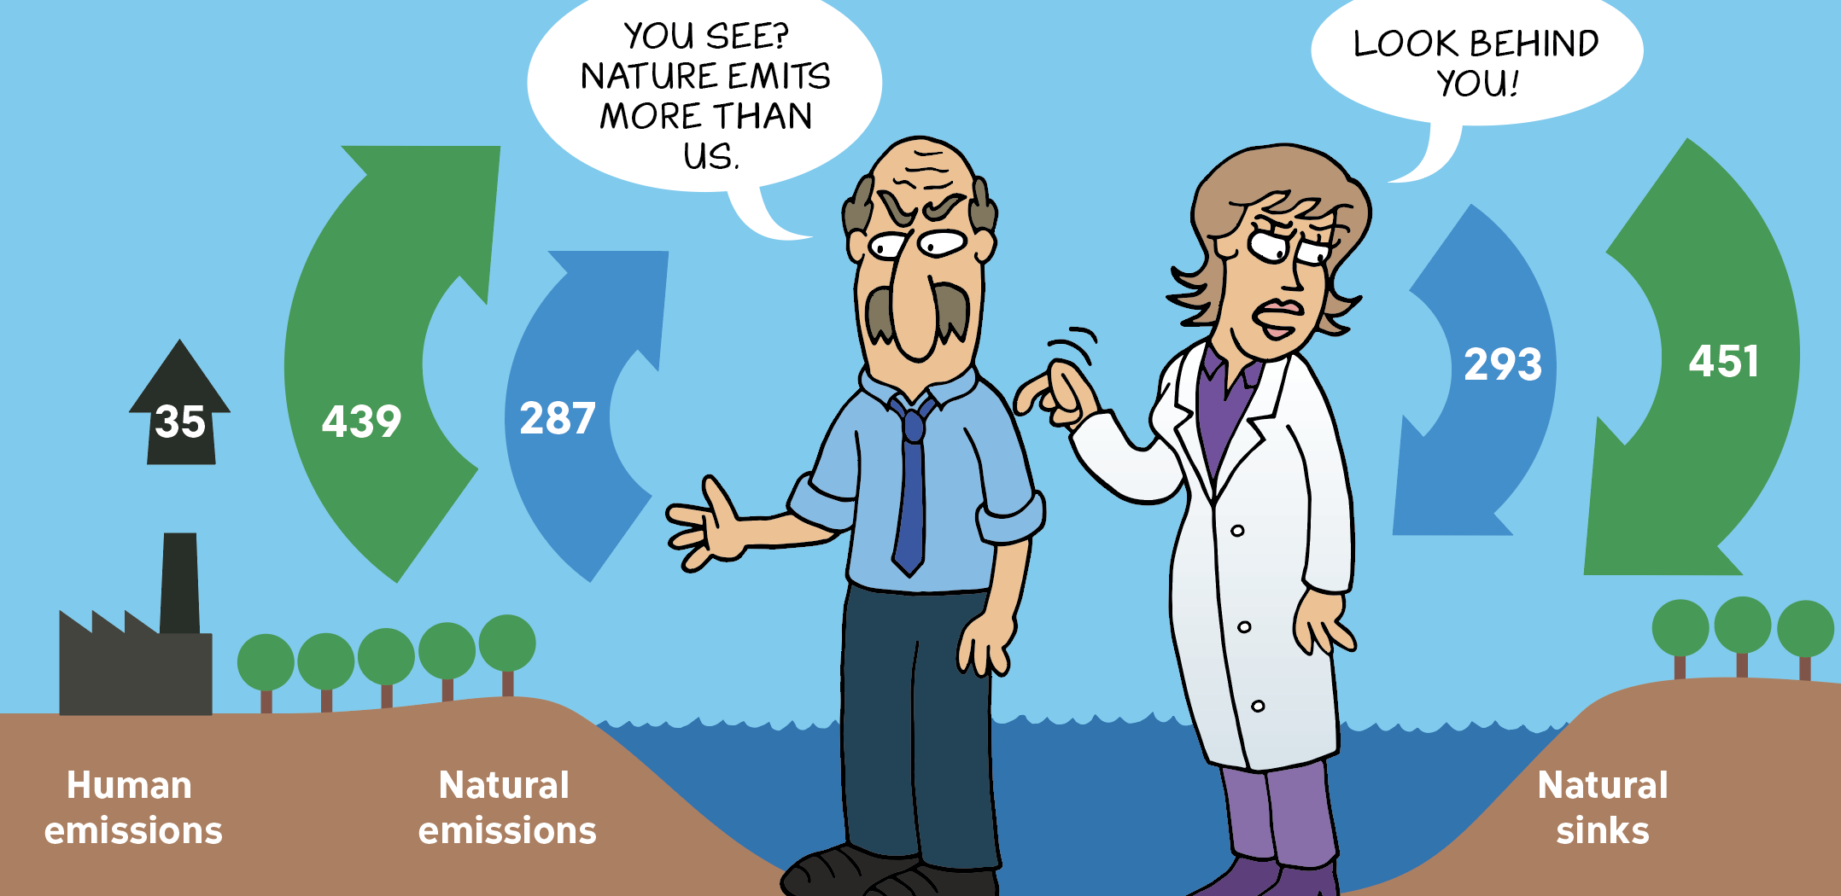
We are causing global warming
FACT
For thousands of years, our atmosphere has been in balance. Humans have upset the balance..
MYTH
Human CO₂ emissions are tiny compared to natural CO₂ emissions so our influence is negligible.
FALLACY
Considers only natural CO₂ emissions and ignores natural CO₂ sinks.
Source - https://skepticalscience.com/graphics/CrankyCartoon-CarbonCycle-EN.jpg
Over-
simplification
http://sks.to/co2

Slide 17
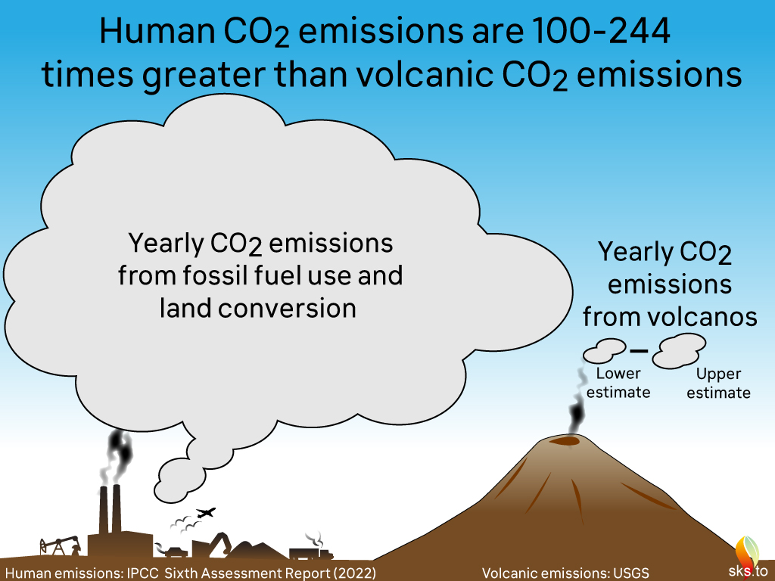
We are causing global warming
FACT
Human emissions are responsible for all of the increase in CO₂ in the air over the past two centuries.
MYTH
Volcanoes produce more CO2 than humans.
FALLACY
Volcanoes do produce CO₂, but over recent centuries the amounts are too small to account for the observed changes in the air. We emit 100 to 244 more CO₂ than volcanoes.
Skeptical Science - https://skepticalscience.com/graphics.php?g=468
Misrepre-sentation
http://sks.to/volcano

Slide 18
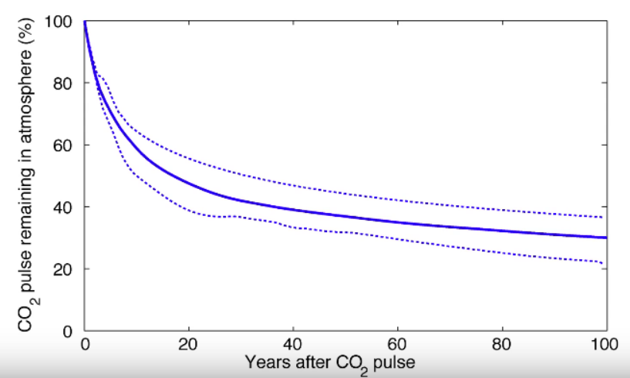
We are causing global warming
FACT
If we stopped emitting CO₂, it would take thousands of years for the atmosphere to return to pre-industrial levels.
MYTH
CO₂ has a residence time of only 4 years so CO₂ levels would fall quickly if we stopped emitting.
FALLACY
How quickly a CO₂ molecule moves around the climate system is different to how long it takes CO₂ level to return back to normal.
Denial101x – 3.2.3.1
Over-
simplification
http://sks.to/residence

Slide 19
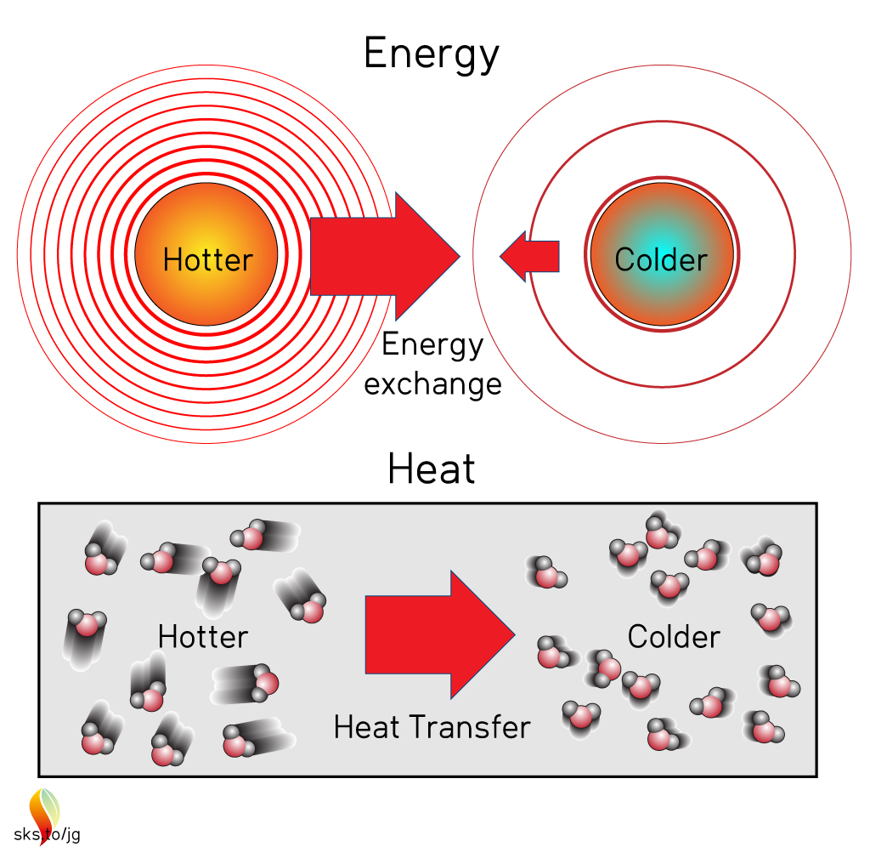
We are causing global warming
FACT
Greenhouse gases are like a blanket. They trap heat, sending it back down to Earth where we measure it.
MYTH
Greenhouse effect violates the 2nd law of thermodynamics.
FALLACY
2nd law talks about net flow of energy and doesn't forbid some flow from cool to hot. The ambiguity of “energy flow” is exploited.
Skeptical Science - https://skepticalscience.com/graphics.php?g=304
Ambiguity
http://sks.to/thermo

Slide 20
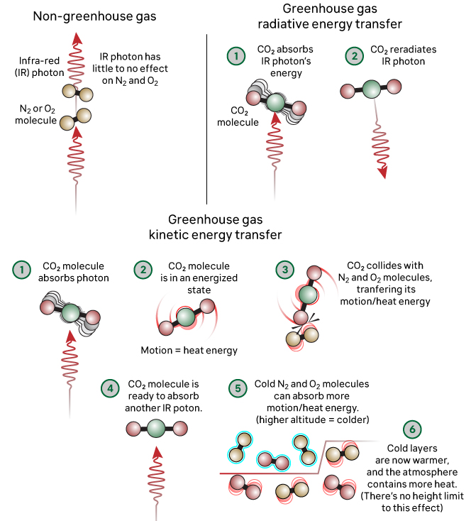
We are causing global warming
FACT
Emitting more CO₂ means more heat is being trapped higher up in the atmosphere where the air is thinner.
MYTH
The greenhouse effect is saturated so adding more CO₂ won't affect it.
FALLACY
Considers the atmosphere as a single layer when it's multiple layers.
Skeptical Science: https://skepticalscience.com/graphics.php?g=475
Over-
simplification
http://sks.to/saturate

Slide 21
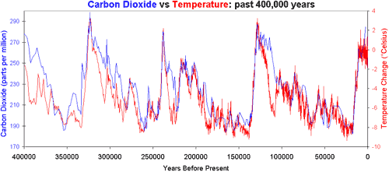

We are causing global warming
FACT
Ice cores tell us warming causes the ocean to emit more CO₂. Combined with greenhouse effect, this is a reinforcing feedback.
MYTH
CO₂ lagging temperature means greenhouse effect is minimal.
FALLACY
It's not one or the other but both. CO₂ causes warming and warming causes CO₂ to rise.
Vostok Antarctic ice core records for carbon dioxide concentration (Petit 2000) and temperature change (Barnola 2003)
False Choice
http://sks.to/lag

Slide 22
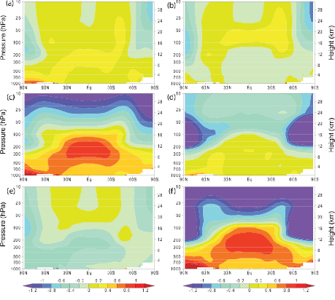
We are causing global warming
FACT
One human fingerprint is a cooling upper atmosphere with a warming lower atmosphere. Satellites have measured this pattern.
MYTH
One fingerprint of human-caused global warming is the tropospheric hot spot which hasn't been observed.
FALLACY
A hot spot should appear for any type of surface warming so is not
linked uniquely to greenhouse warming.
Atmospheric temperature change from 1890 to 1990 from (a) solar forcing, (b) volcanoes, (c) greenhouse gases, (d) ozone, (e) sulfate aerosols and (f) sum of all forcing (IPCC AR4)
Ambiguity
http://sks.to/hotspot

Slide 23
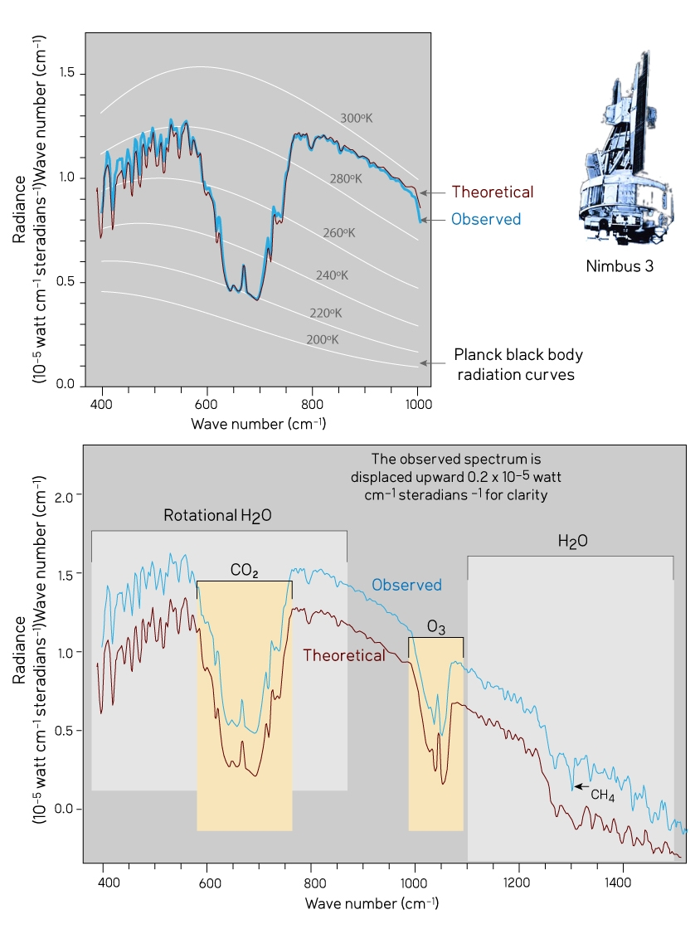

We are causing global warming
FACT
Satellites measure the warming effect from CO2. The increased greenhouse effect is an observed reality. It was predicted before it could be measured.
MYTH
CO₂ is a trace gas so it’s warming effect is minimal.
FALLACY
The fact that CO2 is a trace gas is irrelevant to whether it can impact climate. Trace amounts of substances can have a strong effect.
Red
Herring
Skeptical Science - https://skepticalscience.com/graphics.php?g307
http://sks.to/trace

Slide 24
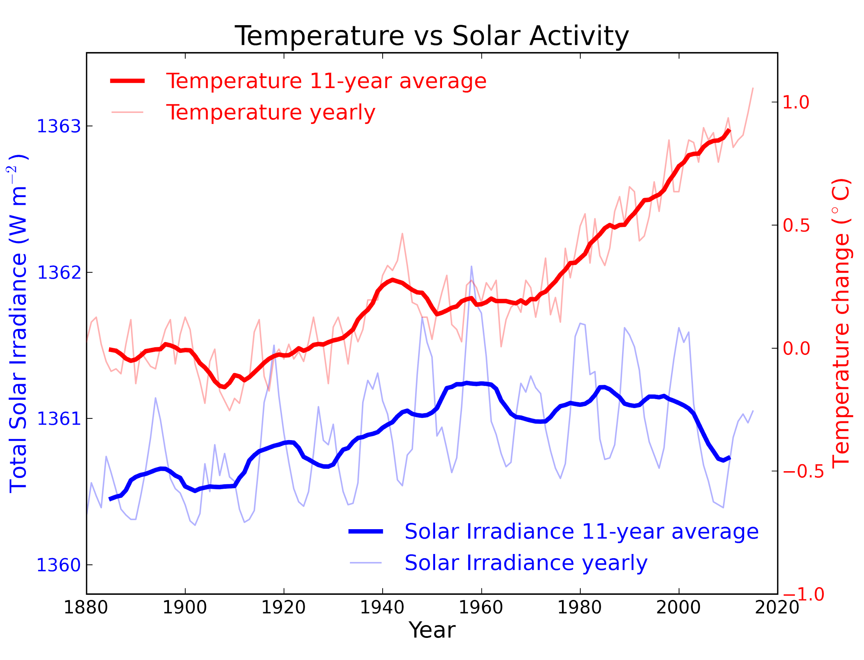
We are causing global warming
FACT
The Sun has been getting colder for the
last 30 years as the Earth has been warming. Sun and climate are moving in opposite directions.
MYTH
The sun is causing global warming.
FALLACY
Ignores human fingerprints and recent period where sun and climate move in opposite directions.
Skeptical Science - https://skepticalscience.com/graphics.php?g=5
Cherry-
picking
http://sks.to/sun

Slide 25
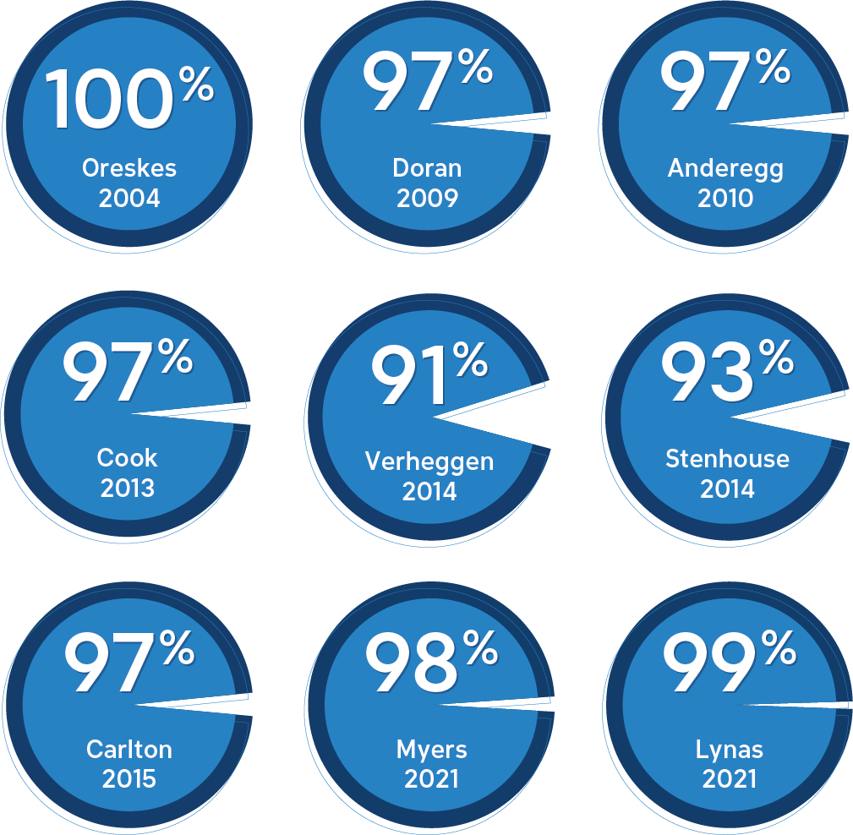

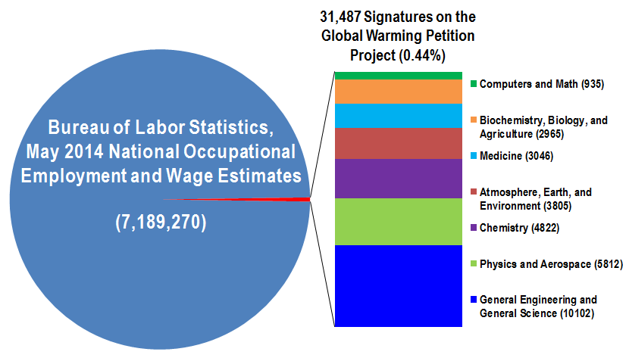

Consensus
FACT
Between 90 and 100 % of climate experts agree that we are mostly responsible for current global warming.
MYTH
More than 31,000 scientists disagree with the consensus.
Fake
Experts
FALLACY
The myth relies on fake experts and a magnified minority. Just about 0.1 % of signees are actively publishing climate scientists while most of them work in other areas.
Magnified Minority
Brian Angliss – Scholars & Rogues (2015)
http://sks.to/consensus

Slide 26
Global Warming is happening
1998
Cold
Glacier
Greenland
Antarctica
Temp
UHI
Winter
Name
We are causing Global Warming
CO₂
Volcano
Residence
Thermo
Saturate
Lag
Hotspot
Trace
Sun
Consensus
Past and future climate change
Past
LIA
Past CO₂
MWP
Model
Hansen1988
Weather
1970s
Iceage
Climate change impacts
Vapor
Cloud
Species
Bear
Acid
Impacts
Pollutant
Plant
Extreme

Slide 27
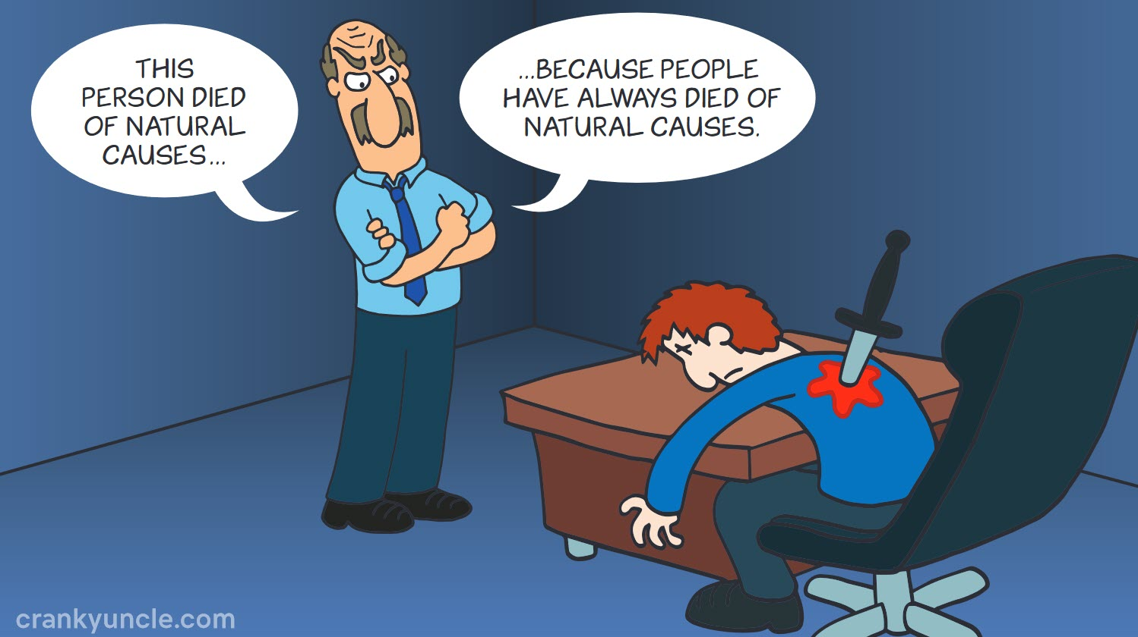

Past and future climate change
FACT
Past climate change tells us climate is sensitive to the warming effect of CO₂.
MYTH
Natural climate change in the past implies current climate change is also natural.
FALLACY
Although climate change happened naturally in the past, today’s cause is human activity.
Skeptical Science - https://skepticalscience.com/graphics.php?g=417
Single Cause
http://sks.to/past

Slide 28
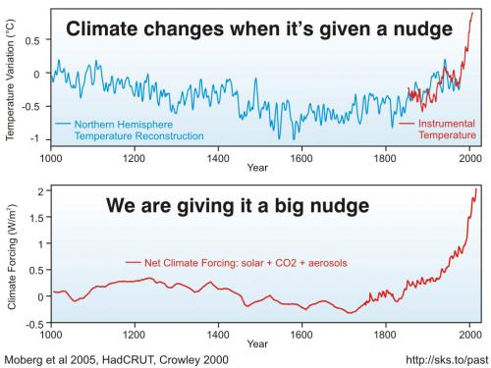
Past and future climate change
FACT
Natural influences that ended the Little Ice Age have been swamped by recent human activity.
MYTH
Current warming is just the continuation of natural recovery from the Little Ice Age.
FALLACY
The natural factors that ended the Little Ice Age are no longer significant.
Skeptical Science - https://skepticalscience.com/graphics.php?g=40
Single Cause
http://sks.to/lia

Slide 29
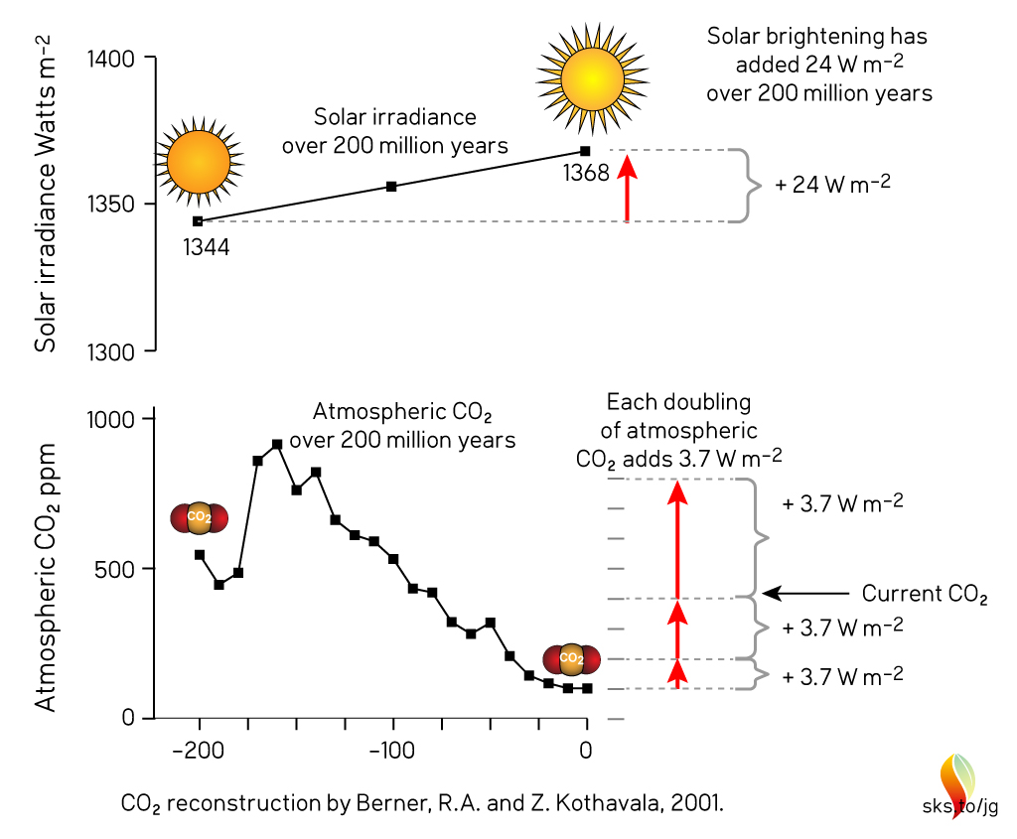

Past and future climate change
FACT
In the past when the sun was cooler, CO₂ was higher. The two roughly balanced each other. We are now raising CO₂ levels with a warmer sun.
MYTH
CO₂ was higher in the past but the world didn't boil away so the greenhouse effect is weak.
FALLACY
Ignores the role of the sun which was cooler in the past.
Skeptical Science - https://skepticalscience.com/graphics.php?g=303
Slothful induction
http://sks.to/pastco2

Slide 30
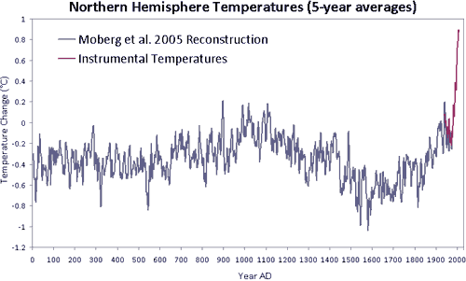
Past and future climate change
FACT
While the Medieval Warm Period saw unusually warm temperatures in some regions, globally the planet was cooler than now.
MYTH
The Medieval Warm Period was warmer than current conditions. This implies recent warming is not unusual and must be natural.
FALLACY
For average temperature over wide regions, the hot regions were cancelled out by other cool regions.
Northern Hemisphere Temperature Reconstruction by Moberg et al. (2005) shown in blue, Instrumental Temperatures from NASA shown in Red.
Slothful induction
http://sks.to/mwp

Slide 31
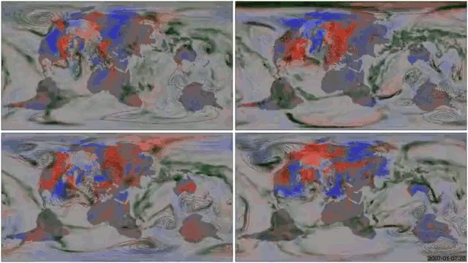
Past and future climate change
FACT
Models are based on fundamental physical principles.
MYTH
Models are unreliable.
MIROC5
ERA-Interim
FALLACY
No model is perfect but they are useful tools that can reproduce the past and provide insights into the future.
HadGEM2
CCSM4
One of these panels shows observed weather (as estimated by Era-Interim); the other three weather simulated by three different climate models (HadGEM2, CCSM4, and MIROC5) - which is which? Click to find out!
Video from Philip Brohan - https://vimeo.com/213117747
Impossible
Expectations
http://sks.to/model

Slide 32
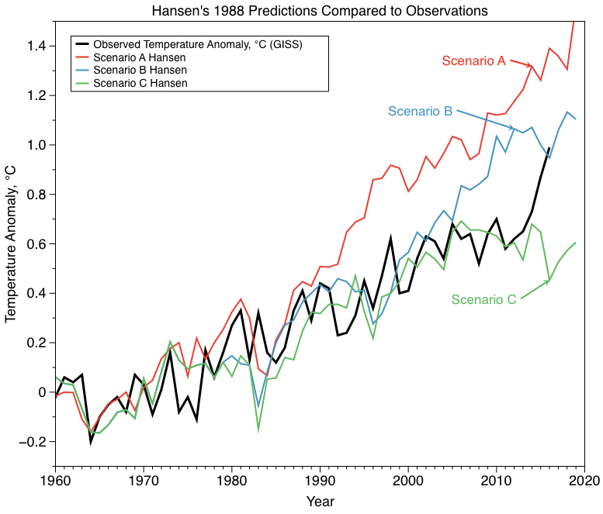
Past and future climate change
FACT
Models have made a number of successful predictions.
MYTH
Models predictions have failed, making them unreliable.
FALLACY
Climate models have had great success at predicting long-term effects like greenhouse warming.
Impossible
Expectations
http://sks.to/hansen1988

Slide 33
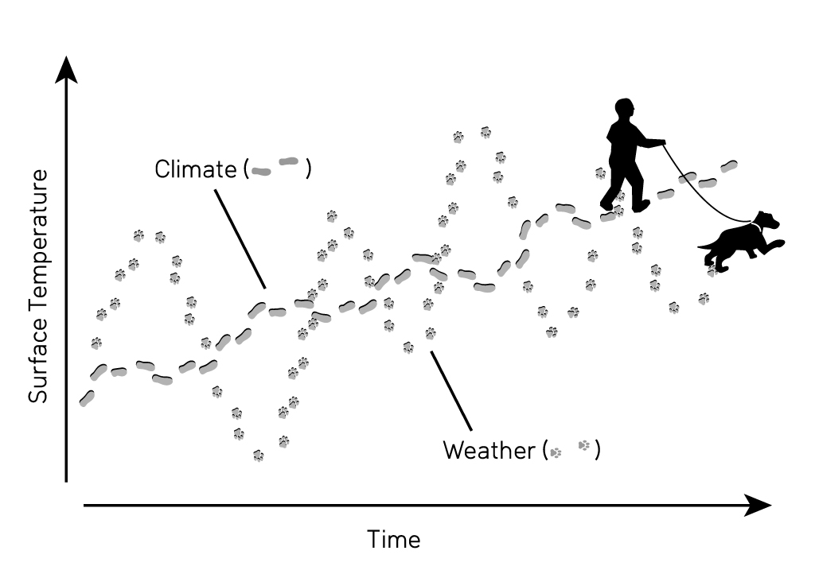
Past and future climate change
FACT
Climate models simulate climate which is weather averaged over time.
MYTH
Scientists can’t even predict weather.
FALLACY
Confusing weather with climate distracts from the fact that short-term predictions have little relevance to long-term climate predictions.
Skeptical Science - https://skepticalscience.com/graphics.php?g=308
Ambiguity
http://sks.to/weather

Slide 34
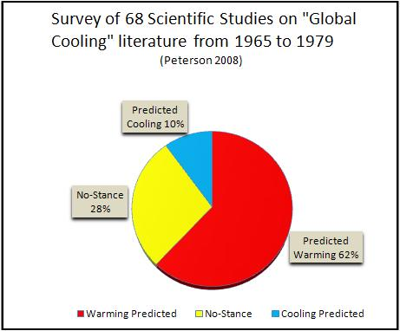
Past and future climate change
FACT
In the 1970s, the majority of climate papers were predicting warming.
MYTH
In the 1970s, climate scientists were predicting an ice age.
FALLACY
Confuses mainstream media reports with scientific papers which overwhelmingly pointed towards warming.
Misrepre-
sentation
http://sks.to/1970s

Slide 35
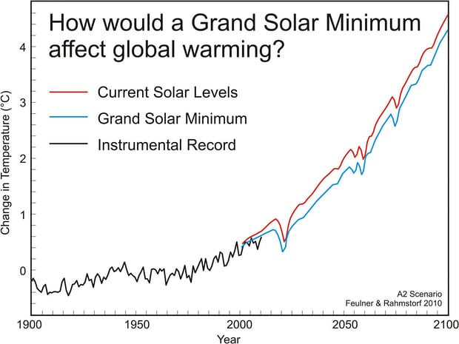
Past and future climate change
FACT
Even if the sun fell to Maunder Minimum levels, it would only delay global warming by a decade.
MYTH
We're heading into another ice age because of the cooling sun.
FALLACY
Overstating the role of solar activity on climate - it actually has had little effect.
Skeptical Science - https://skepticalscience.com/graphics.php?g=21
Single Cause
http://sks.to/iceage

Slide 36
Global Warming is happening
1998
Cold
Glacier
Greenland
Antarctica
Temp
UHI
Winter
Name
We are causing Global Warming
CO₂
Volcano
Residence
Thermo
Saturate
Lag
Hotspot
Trace
Sun
Consensus
Past and future climate change
Past
LIA
Past CO₂
MWP
Model
Hansen1988
Weather
1970s
Iceage
Climate change impacts
Vapor
Cloud
Species
Bear
Acid
Impacts
Pollutant
Plant
Extreme

Slide 37
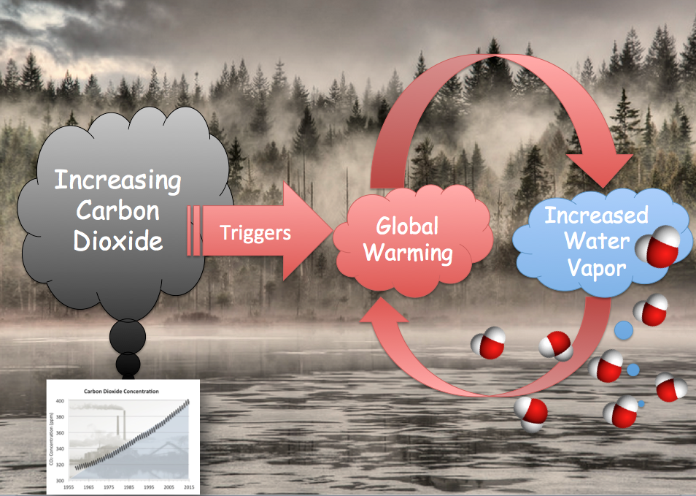
Climate change impacts
FACT
The amount of water vapor in the air depends on temperature. Warming causes water vapor to rise, which causes further warming: a reinforcing feedback.
MYTH
Water vapor is the strongest greenhouse gas so CO2 emissions don’t matter.
FALLACY
The fact that water vapor is a strong greenhouse gas means it amplifies the warming from greenhouse gases.
Denial101x - 5.2.2 - Water Vapor
Misrepre-sentation
http://sks.to/vapor

Slide 38
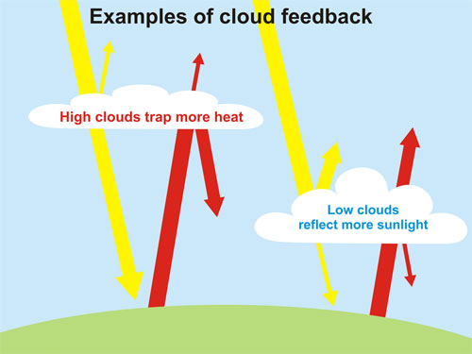
Climate change impacts
FACT
Clouds provide a reinforcing feedback but the effect isn't strong. Clouds play a minor role in climate sensitivity
MYTH
Clouds provide negative feedback
FALLACY
Acting as if clouds only have a cooling effect ignores that they can also warm.
Skeptical Science - https://skepticalscience.com/graphics.php?g=21
Over-
simplification
http://sks.to/cloud

Slide 39
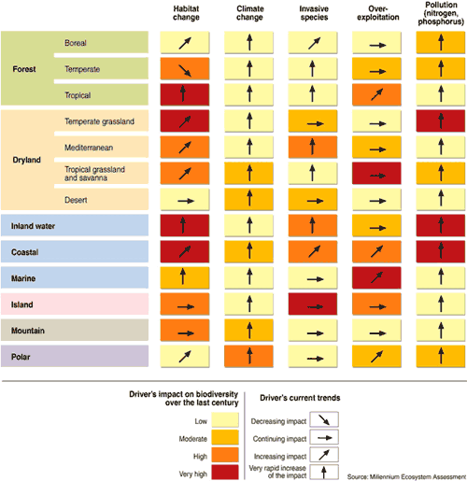
Climate change impacts
FACT
Mass extinctions happen when climate changes too fast for species to adapt. Currently species are going extinct at similar rates to past mass extinctions.
MYTH
Species can adapt to climate change.
FALLACY
Just because species can adapt to some climate change doesn’t mean they can adjust to the rapid climate change happening now.
Misrepre-
sentation
Figure from the Millennium Ecosystem Assessment
http://sks.to/species
Notes:
Figure from the Millennium Ecosystem Assessment

Slide 40
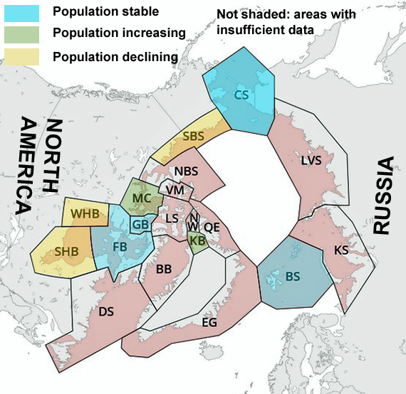
Climate change impacts
FACT
Polar bears need sea ice to hunt so the shrinking of Arctic sea ice is endangering their populations.
MYTH
Polar bear numbers have increased so they're in no danger from global warming.
FALLACY
One threat (hunting) has been removed but replaced with an increasing threat (melting sea ice).
Adapted from:
https://commons.wikimedia.org/wiki/File:Polar_bear_subpopulation_map.svg
Over-
simplification
http://sks.to/bear

Slide 41
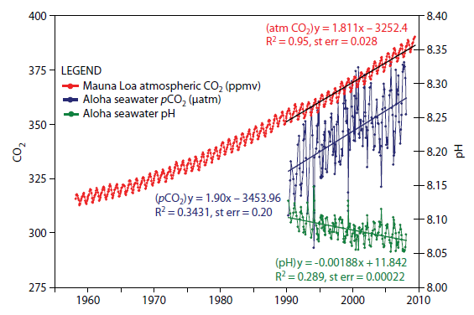
Climate change impacts
FACT
Ocean acidity has increased 30% and poses serious threats to coral reefs that are also threatened by warming oceans and bleaching.
MYTH
Ocean acidification isn’t serious.
FALLACY
Ocean acidification means oceans are decreasing in pH so they are getting more acidic, even if they are not actually acid.
Annual variations in atmospheric CO₂, oceanic CO₂, and ocean surface pH. Strong trend lines for rising CO₂ and falling pH.
Red Herring
http://sks.to/acid

Slide 42
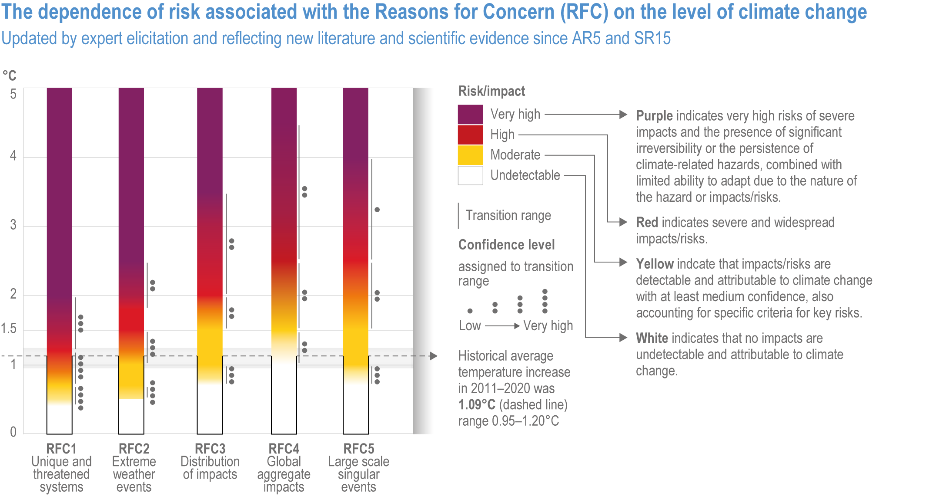
Climate change impacts
FACT
Climate change is having negative impacts on all parts of society.
MYTH
Global warming is good.
FALLACY
This focuses on a few good impacts of global warming but ignores the overwhelming number of bad impacts.
“Burning embers” - https://skepticalscience.com/pics/IPCC_AR6_WGII_Figure_16_FAQ_16_5_1_WithCaption.png
Cherry-
picking
http://sks.to/impacts
Notes:
Risks from climate change, by reason for concern (RFC). Climate change consequences are plotted against increases in global mean temperature (°C) after 1990. Each column corresponds to a specific RFC and represents additional outcomes associated with increasing global mean temperature. The color scheme represents progressively increasing levels of risk and should not be interpreted as representing ‘‘dangerous anthropogenicinterference,’’ which is a value judgment. The historical period 1900 to 2000 warmed by 0.6 °C and led to some impacts. It should be noted that this figure addresses only how risks change as global mean temperature increases, not how risks might change at different rates of warming. Furthermore, it does not address when impacts might be realized, nor does it account for the effects of different development pathways on vulnerability.

Slide 43
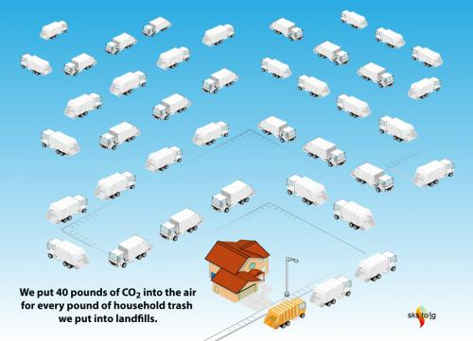
Climate change impacts
FACT
A pollutant is any substance that disrupts the environment - CO₂ does that by trapping heat.
MYTH
CO₂ is not a pollutant.
FALLACY
Quibbling over technical definitions of pollutant is a distraction from the realities of the negative impacts of global warming.
Skeptical Science - https://skepticalscience.com/graphics.php?g=21
Red
Herring
http://sks.to/pollutant

Slide 44
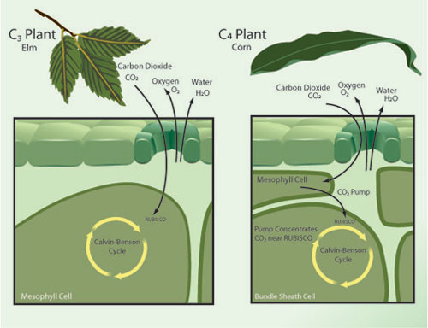
Climate change impacts
FACT
Climate change impacts agriculture through extreme weather: heat stress and flooding.
MYTH
CO₂ is plant food.
FALLACY
CO₂ fertilisation is just one factor affecting plant growth. The full picture shows that negative impacts outweigh benefits.
A simplified diagram contrasting C3 vs. C4 plant photosynthesis. From Nature Magazine.
Slothful Induction
http://sks.to/plant

Slide 45
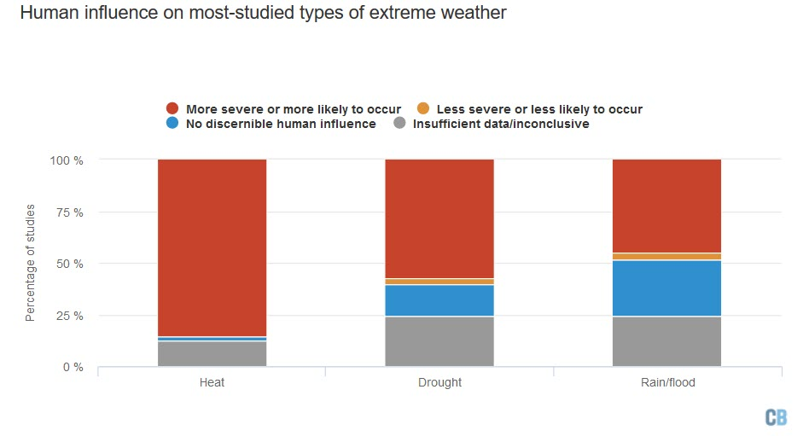
Climate change impacts
FACT
Risk from extreme weather is increasing, albeit some forms of extreme weather are more confidently linked to global warming than others.
MYTH
Extreme weather not linked to global warming.
FALLACY
Just because extreme weather happened in the past doesn’t mean climate change isn’t having an influence now.
Mapped: How climate change affects extreme weather around the world
https://www.carbonbrief.org/mapped-how-climate-change-affects-extreme-weather-around-the-world
Misrepre-sentation
http://sks.to/extreme

Slide 46
Slide-deck put together by
Bärbel Winkler
Email – baerbelw[AT]skepticalscience[DOT]com
Profile - https://sks.to/BaerbelW
Web - https://skepticalscience.com
FLICC Cheat Sheet – https://sks.to/flicc-cheat-sheet

