Slide 1
Countering alternative facts and post-truthism
JOHN COOK

Slide 2
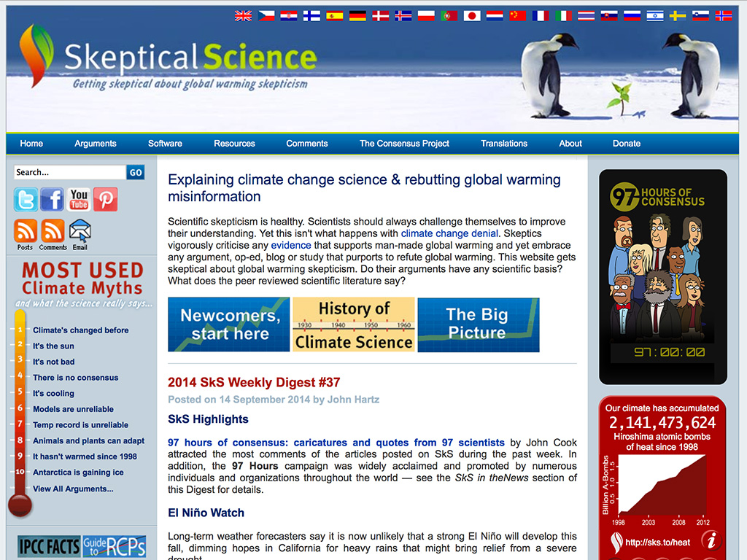

Slide 3
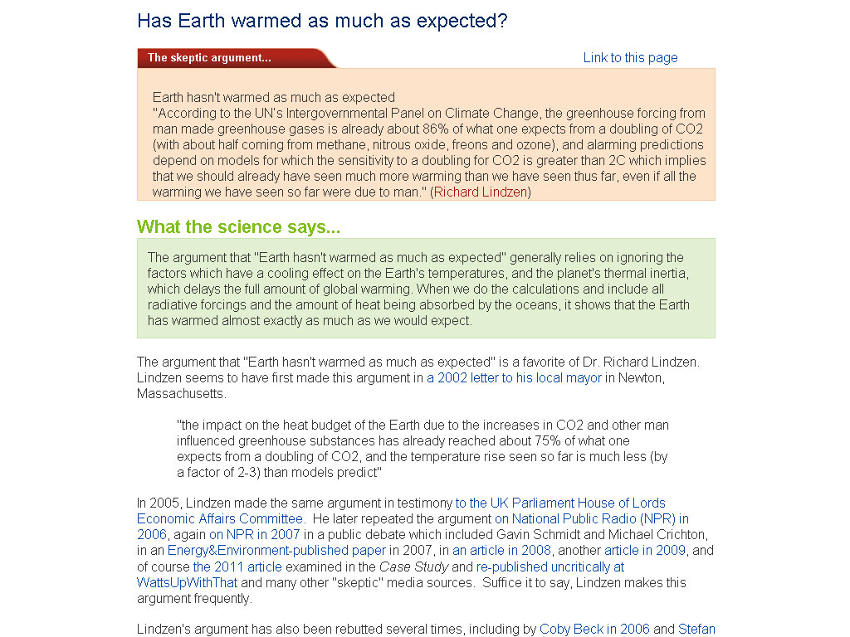

Slide 6
Attribution 2

Slide 9
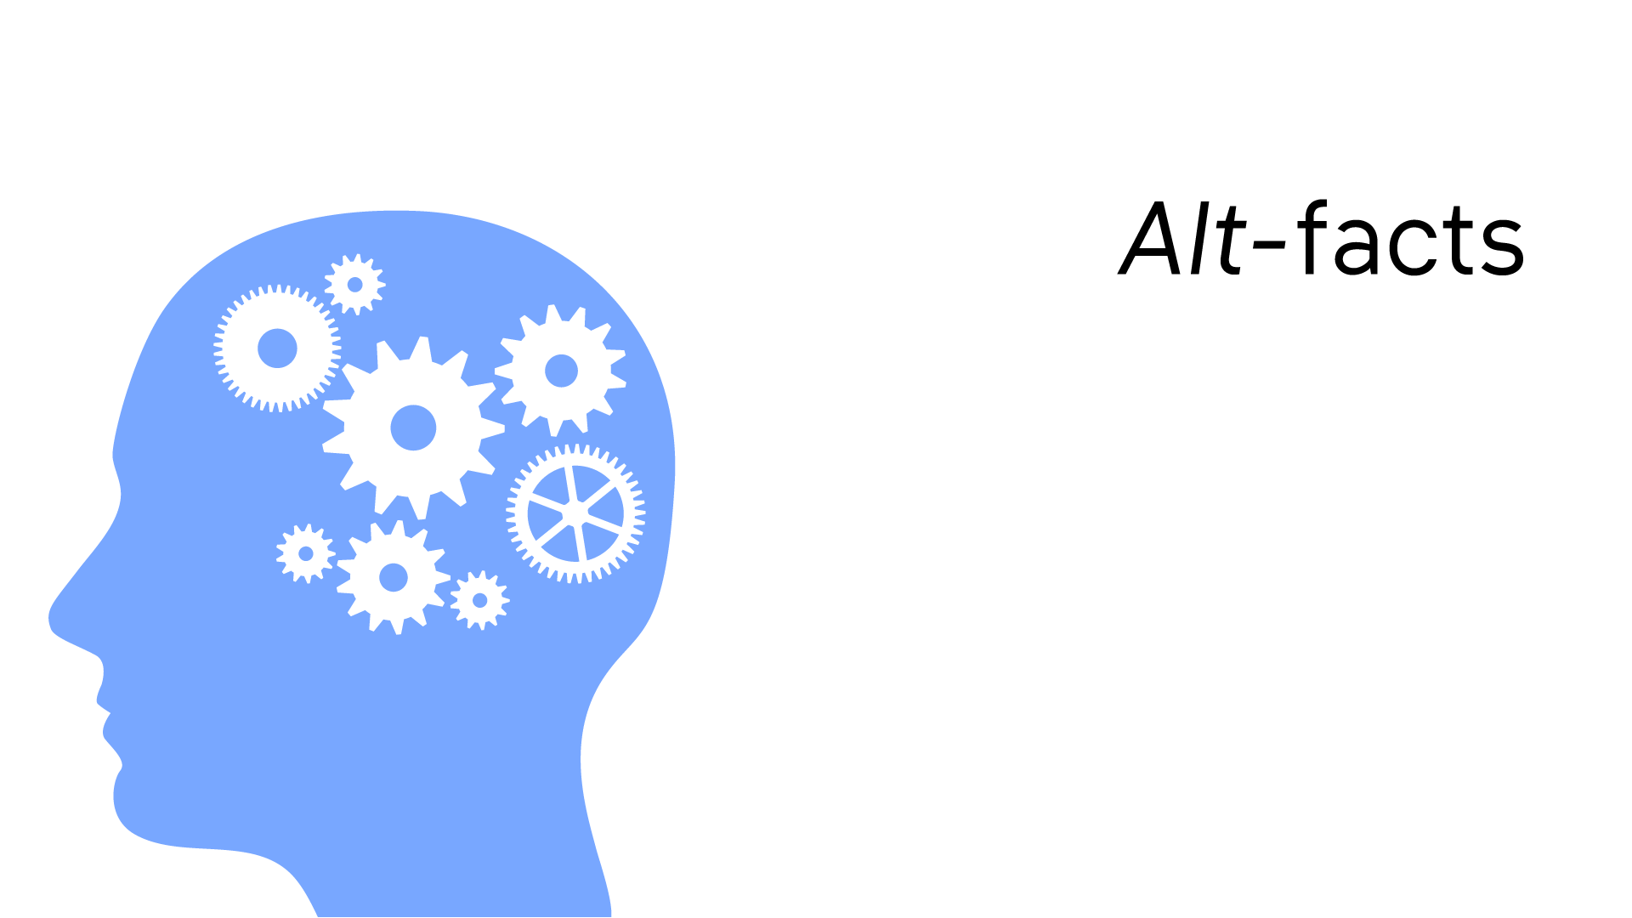

Slide 12
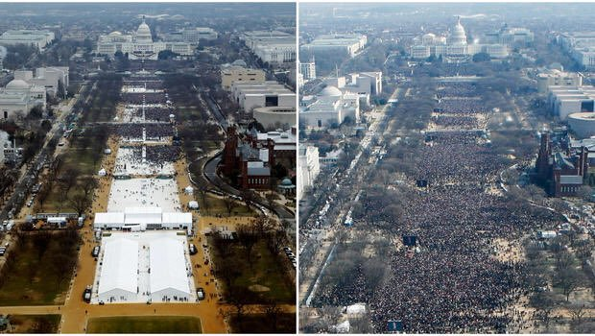

Slide 13
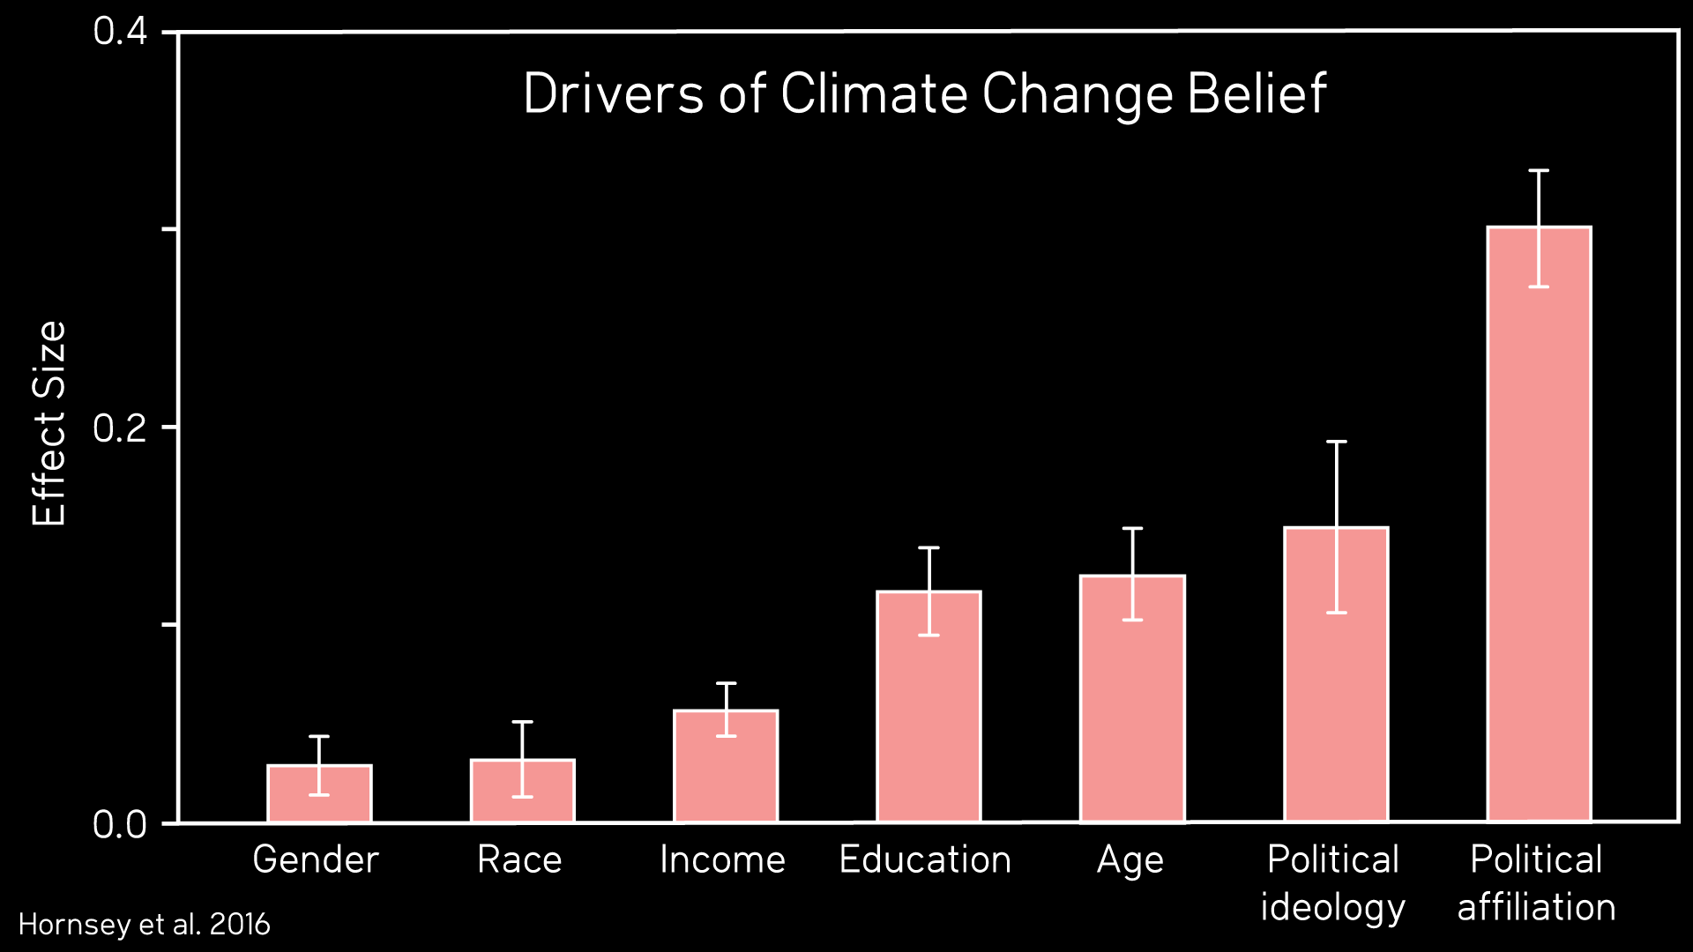
Notes:
A number of factors drive people’s attitudes towards climate change. A meta-analysis by the University of Queensland looked at nearly 200 (196) studies and surveys on climate beliefs and summarised the results. They found that across these studies, the biggest driver of belief in climate change was not gender, age, income or even education level. The biggest driver of climate attitudes is who you vote for. Political affiliation is by far the strongest predictor of climate change beliefs. Now this seems like a strange outcome. What does voting Labour or Liberal have to do with your views on the greenhouse effect?

Slide 18
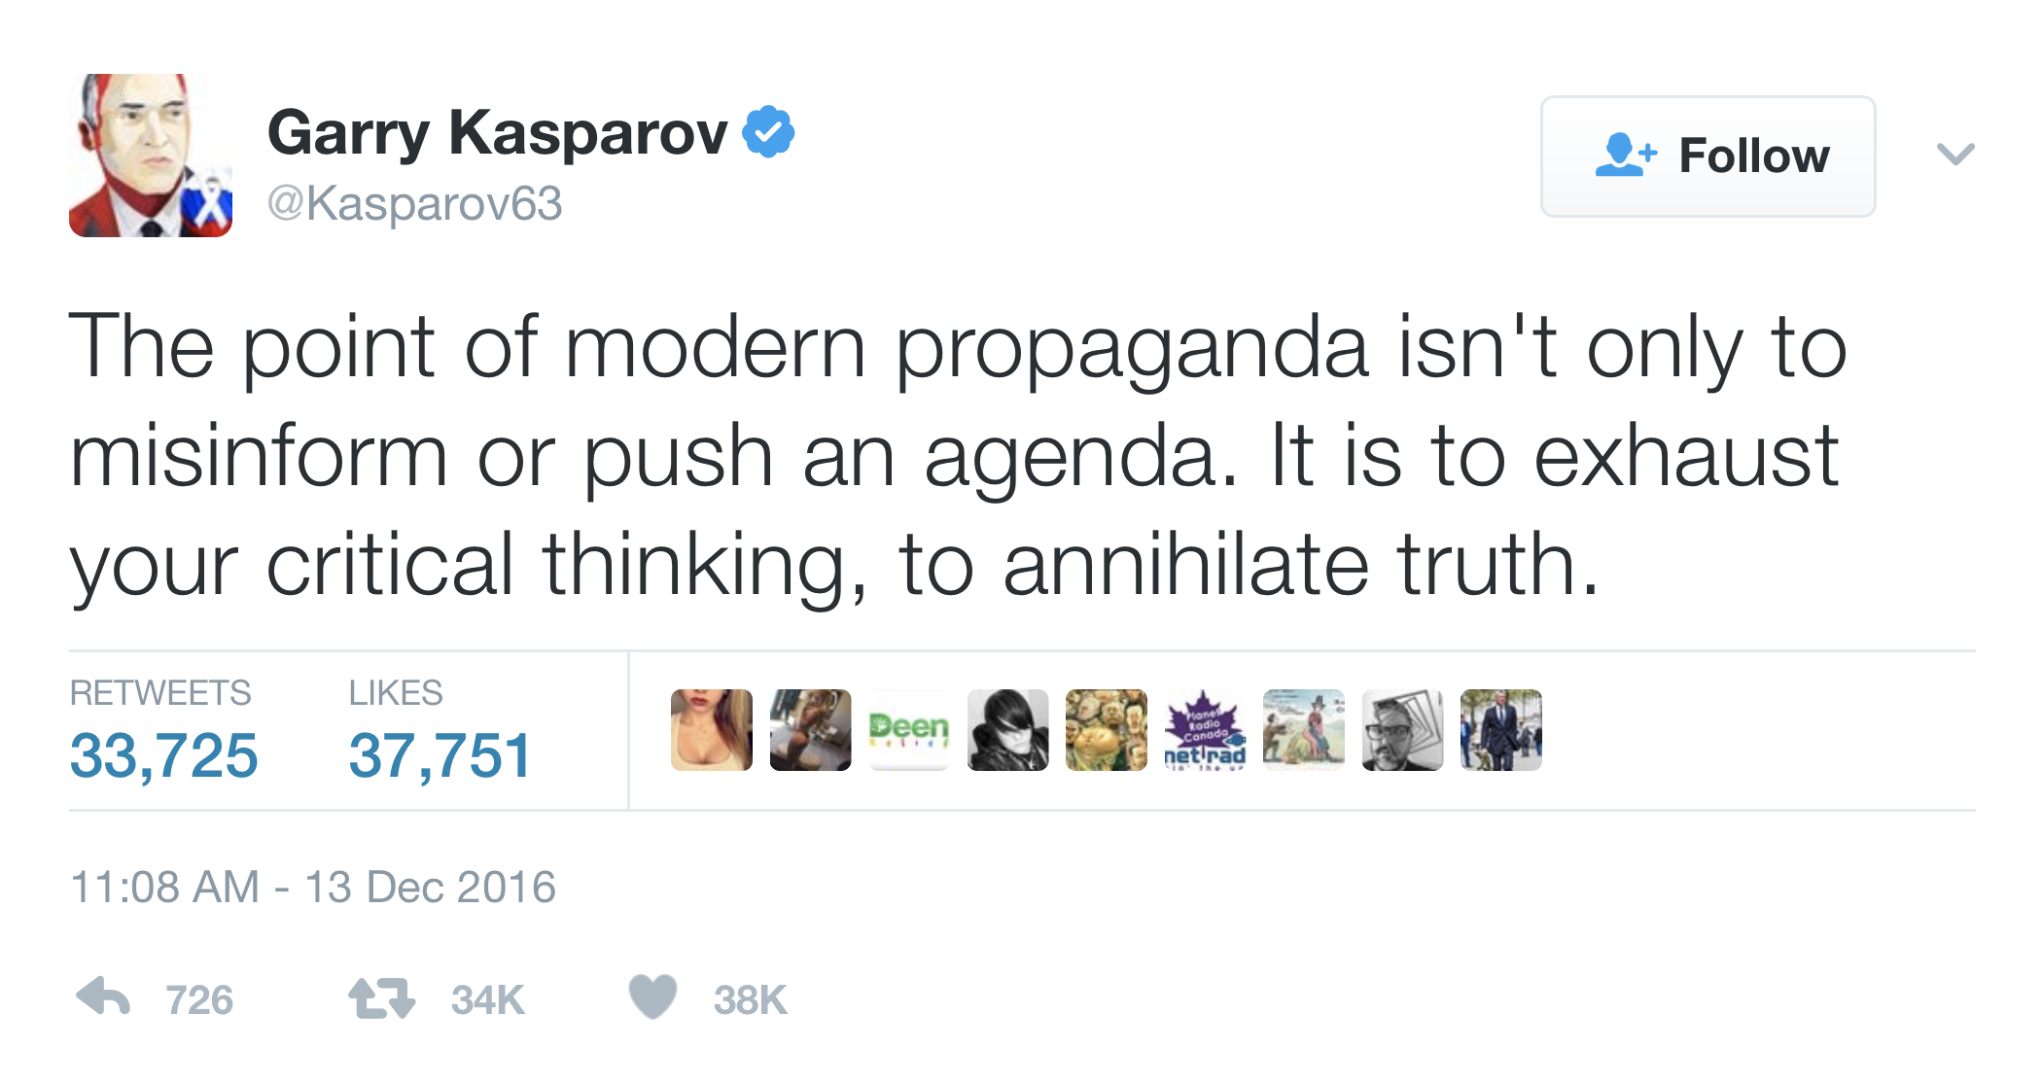

Slide 19
Inoculation theory

Slide 20
Warning Before Misinformation
… several independent investigations have concluded that the “Petition Project” is extremely misleading. For instance, many of the signatures on the petition are fake (for example, past signatories have included the long deceased Charles Darwin, members of the Spice Girls, and fictional characters from Star Wars). Also, although 31,000 may seem like a large number, it actually represents less than 0.3% of all US science graduates (a tiny fraction). Further, nearly all of the legitimate signers have no expertise in climate science at all.

Slide 21
Warning Before Misinformation
… several independent investigations have concluded that the “Petition Project” is extremely misleading. For instance, many of the signatures on the petition are fake (for example, past signatories have included the long deceased Charles Darwin, members of the Spice Girls, and fictional characters from Star Wars). Also, although 31,000 may seem like a large number, it actually represents less than 0.3% of all US science graduates (a tiny fraction). Further, nearly all of the legitimate signers have no expertise in climate science at all.

Slide 22
Warning Before Misinformation
… several independent investigations have concluded that the “Petition Project” is extremely misleading. For instance, many of the signatures on the petition are fake (for example, past signatories have included the long deceased Charles Darwin, members of the Spice Girls, and fictional characters from Star Wars). Also, although 31,000 may seem like a large number, it actually represents less than 0.3% of all US science graduates (a tiny fraction). Further, nearly all of the legitimate signers have no expertise in climate science at all.

Slide 23
Warning Before Misinformation
… several independent investigations have concluded that the “Petition Project” is extremely misleading. For instance, many of the signatures on the petition are fake (for example, past signatories have included the long deceased Charles Darwin, members of the Spice Girls, and fictional characters from Star Wars). Also, although 31,000 may seem like a large number, it actually represents less than 0.3% of all US science graduates (a tiny fraction). Further, nearly all of the legitimate signers have no expertise in climate science at all.

Slide 24
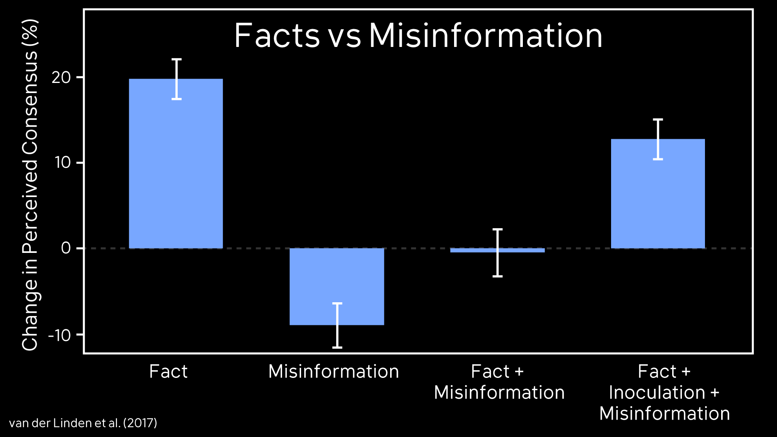

Slide 25
Notes:
Typically, our science communication is just the green section of this slide – explaining the facts. But understanding the facts doesn’t necessarily protect people when they encounter a myth that conflicts with the facts – the two conflicting messages can cancel each other out. To help people develop immunity to misinformation, when we explain the facts, we also need to explain how the facts might get distorted. Then when people encounter a myth, they can reconcile the facts with the myth.

Slide 26
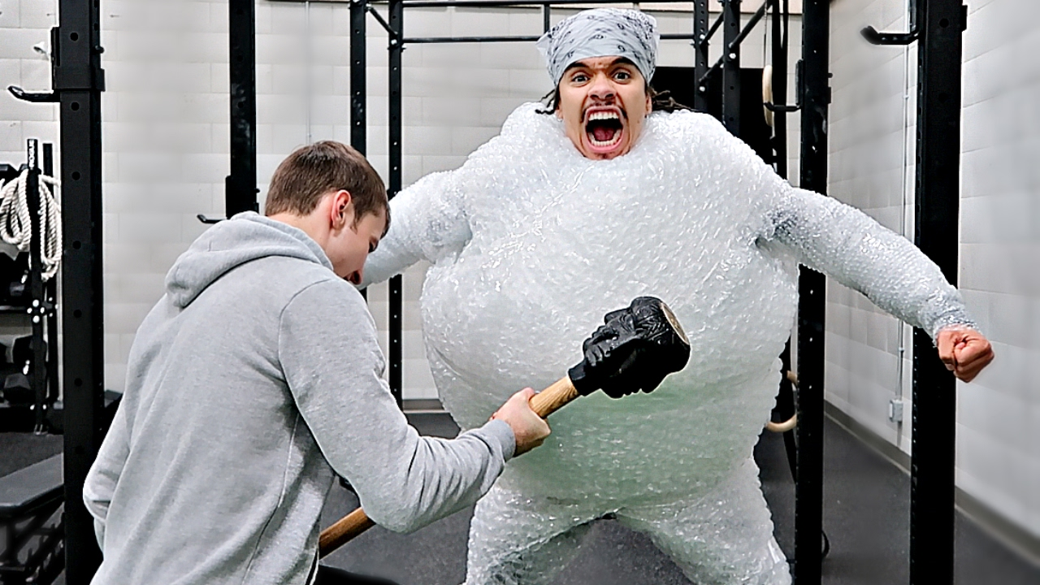

Slide 27
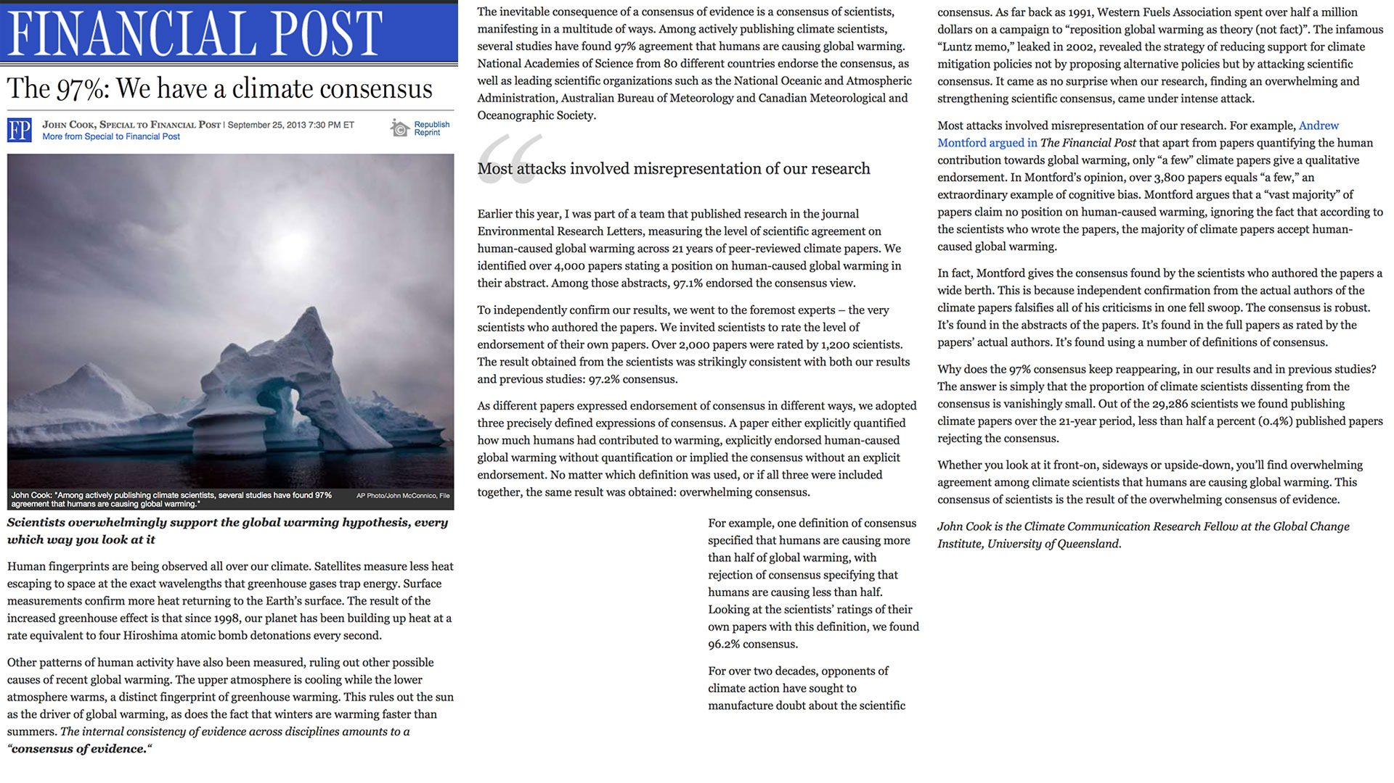

Slide 28
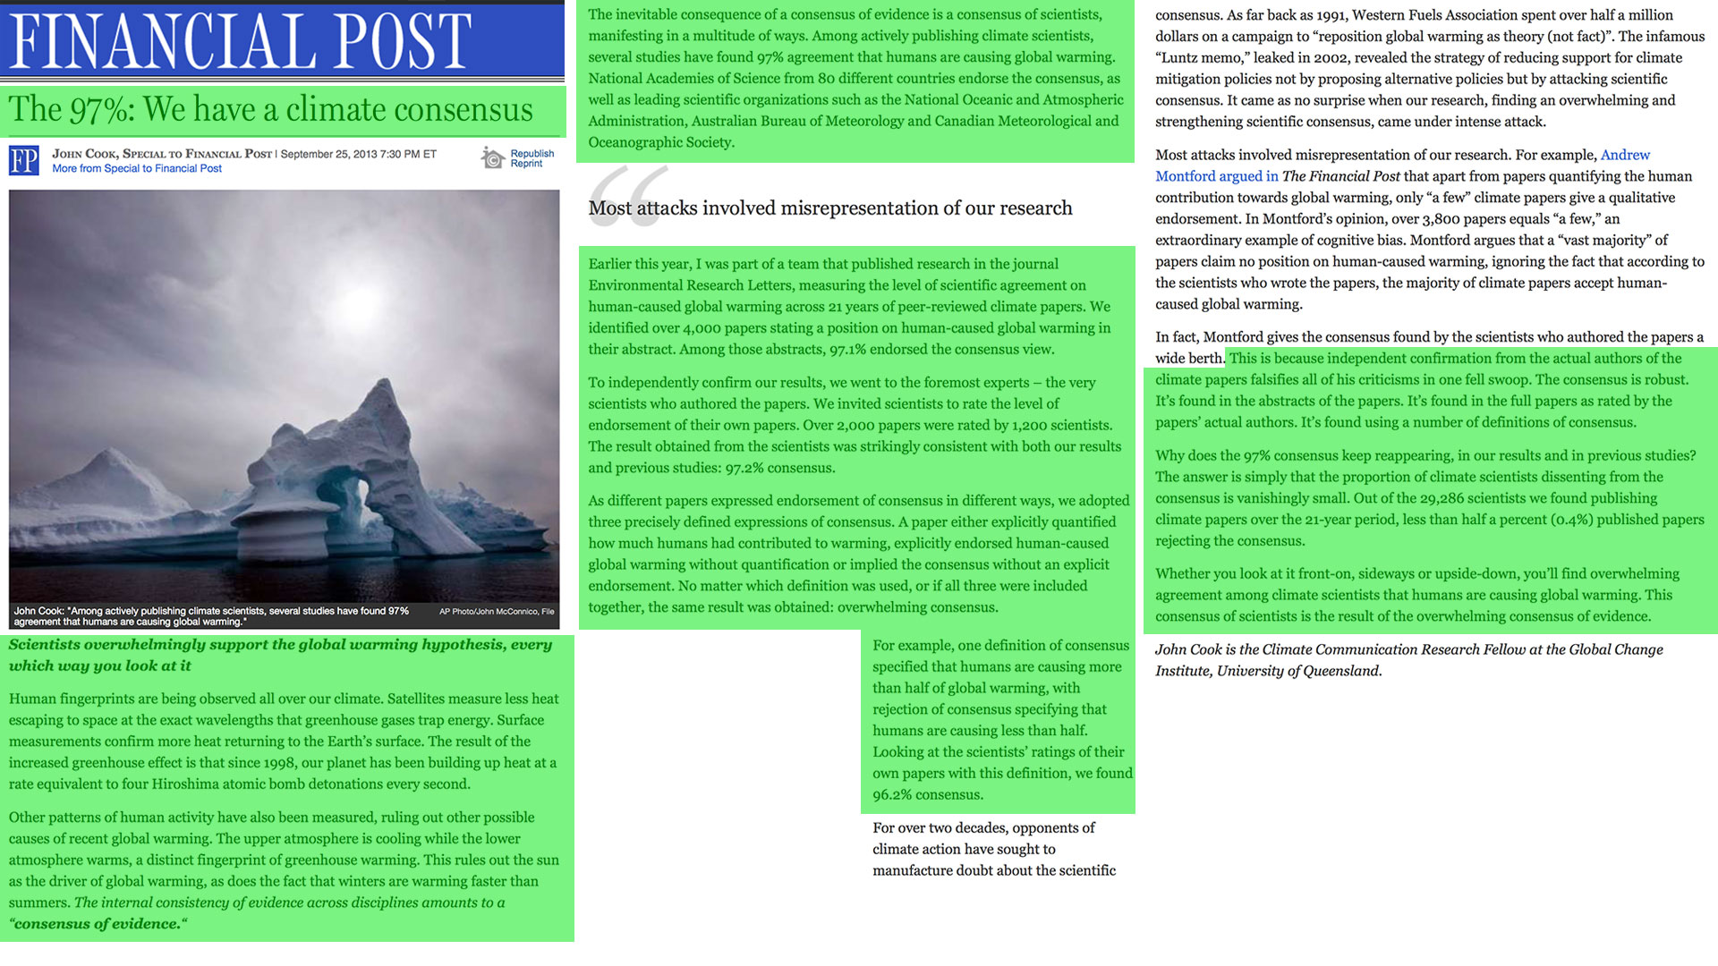

Slide 29
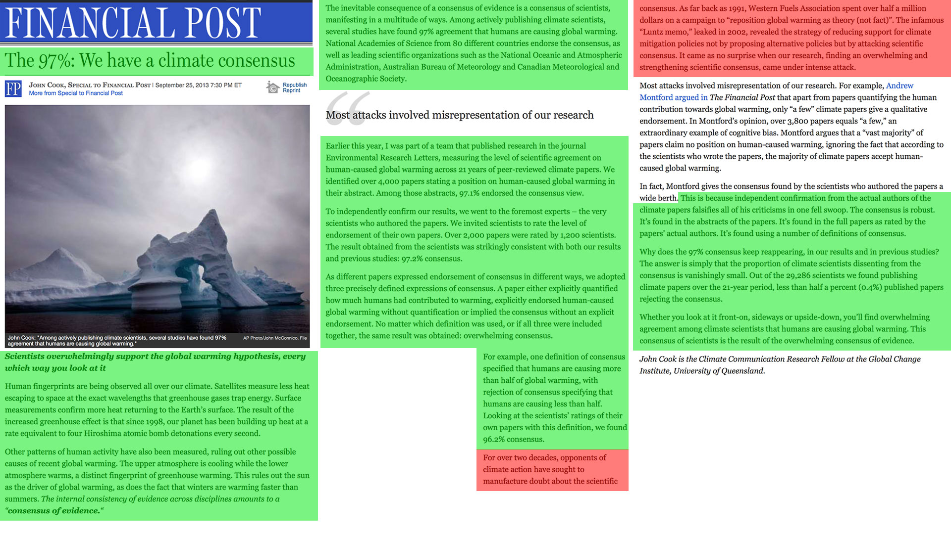

Slide 30
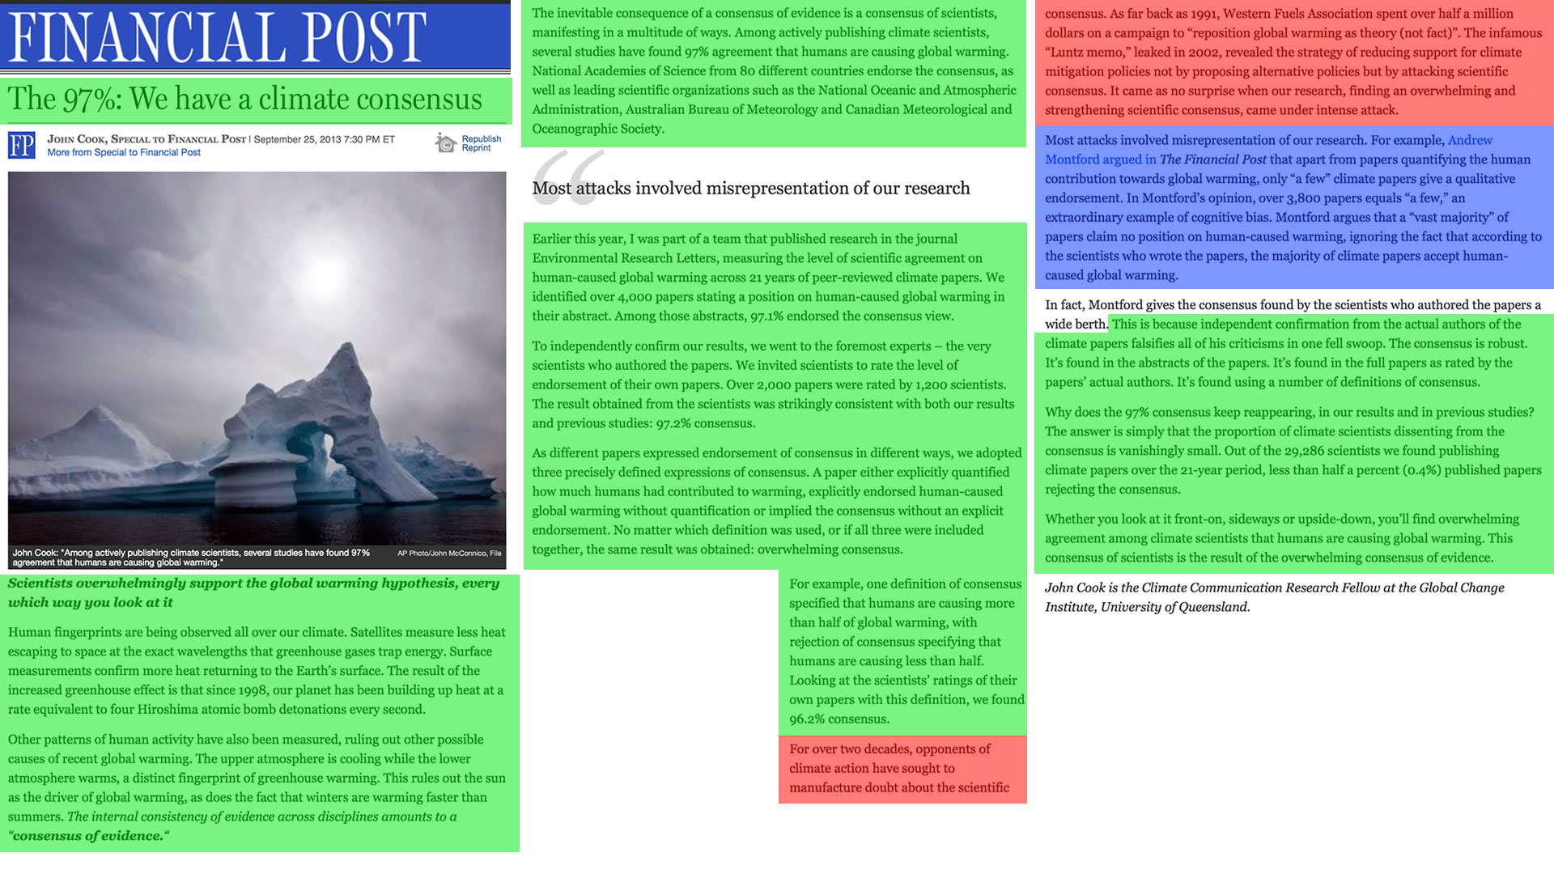

Slide 31
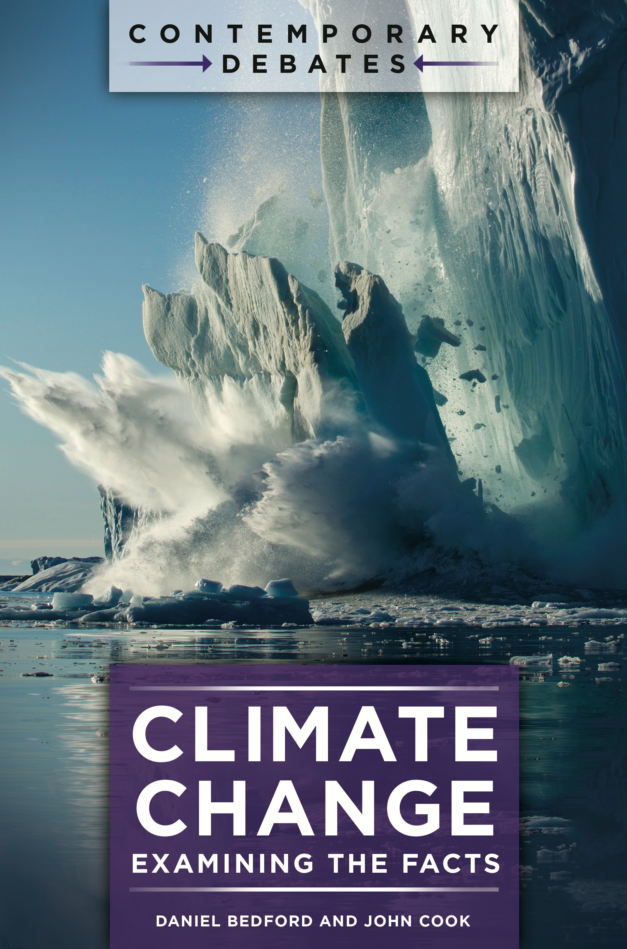

Slide 37
http://edx.org/understanding-climate-denial

Slide 38
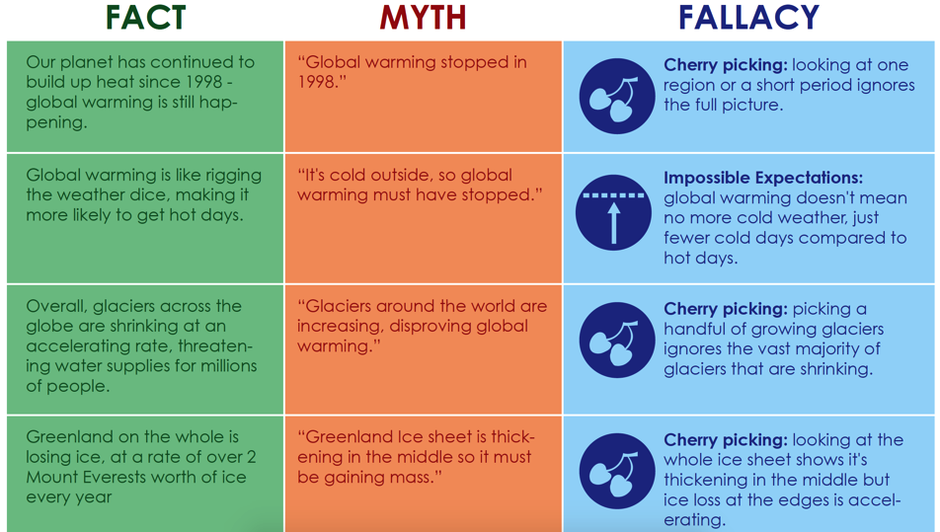
http://edx.org/understanding-climate-denial

Slide 39
Notes:
Typically, our science communication is just the green section of this slide – explaining the facts. But understanding the facts doesn’t necessarily protect people when they encounter a myth that conflicts with the facts – the two conflicting messages can cancel each other out. To help people develop immunity to misinformation, when we explain the facts, we also need to explain how the facts might get distorted. Then when people encounter a myth, they can reconcile the facts with the myth.

Slide 41
John Cook
Email: jcook20@gmu.edu
Web: http://www.skepticalscience.com
Denial101x MOOC: http://sks.to/denial101x

Slide 42
s.u.c.c.e.s.
Simple
Unexpected
Credible
Concrete
Emotional
Story

