Slide 1
Responding to misinformation in the age of fake news
JOHN COOK
Notes:
Tonight, I’d like to talk about the science of science denial. What does psychological research tell us about why people deny climate science. How do people reject climate science? And most importantly, how do we respond to science denial? But before I jump into the psychology of climate science denial, I want to take a step back and look at science denial in general.

Slide 2
1
How misinformation does damage

Slide 7
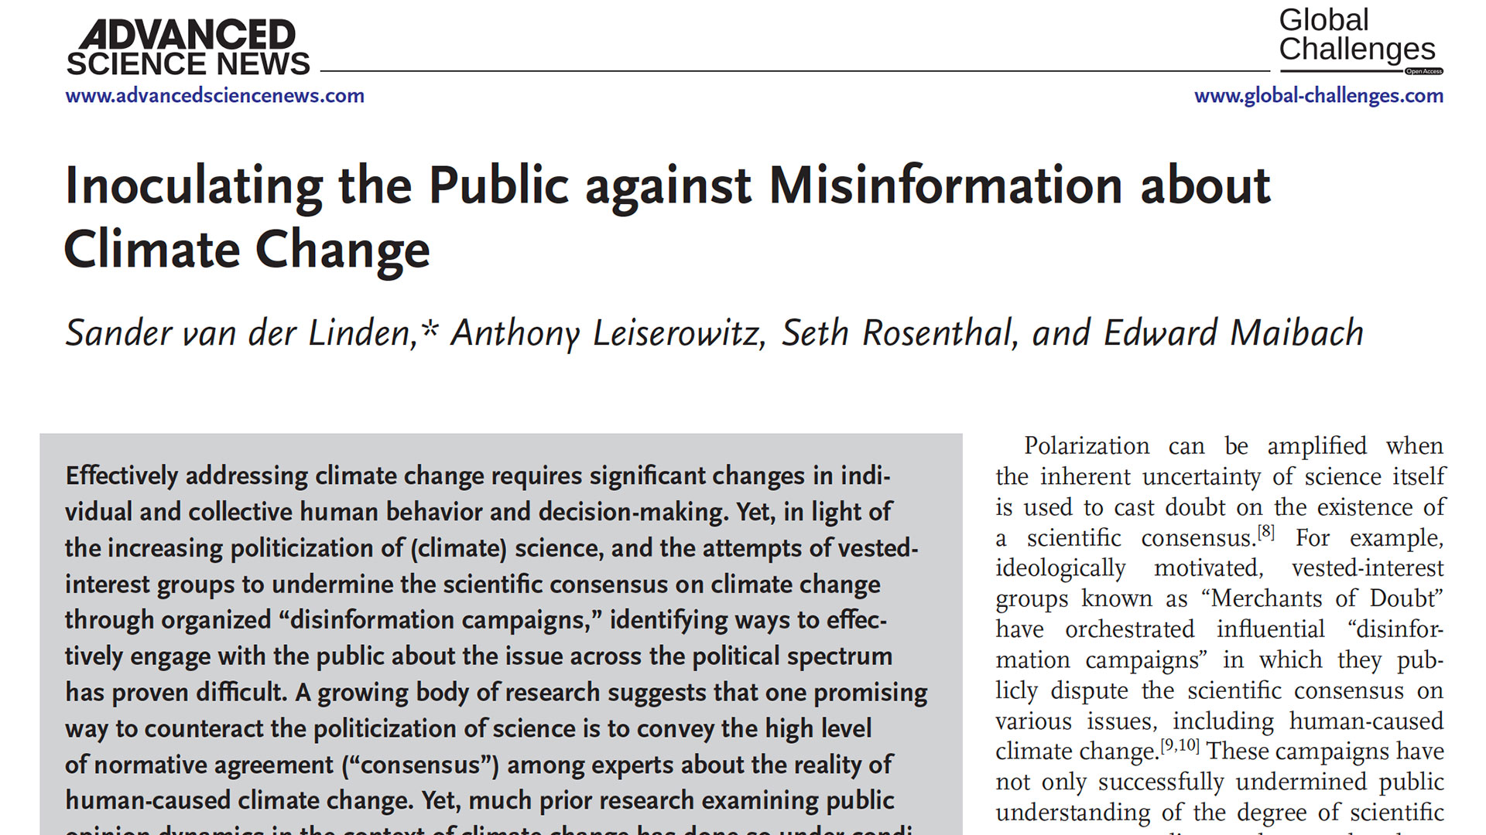

Slide 8
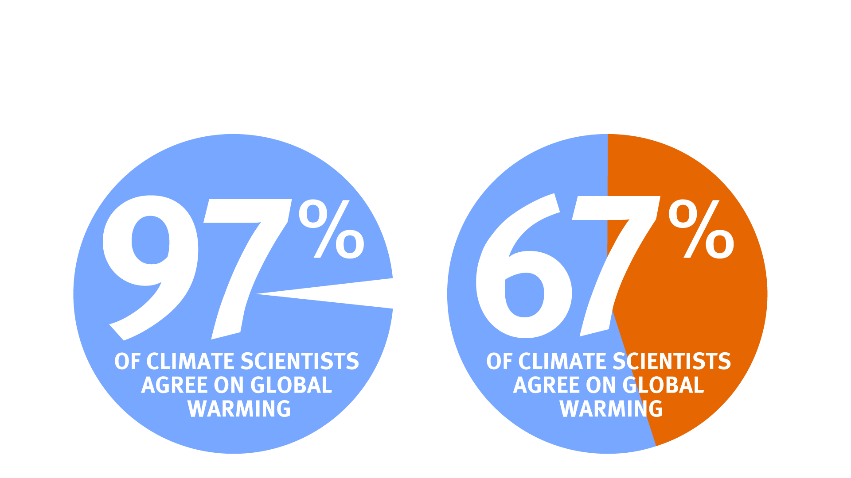

Slide 10
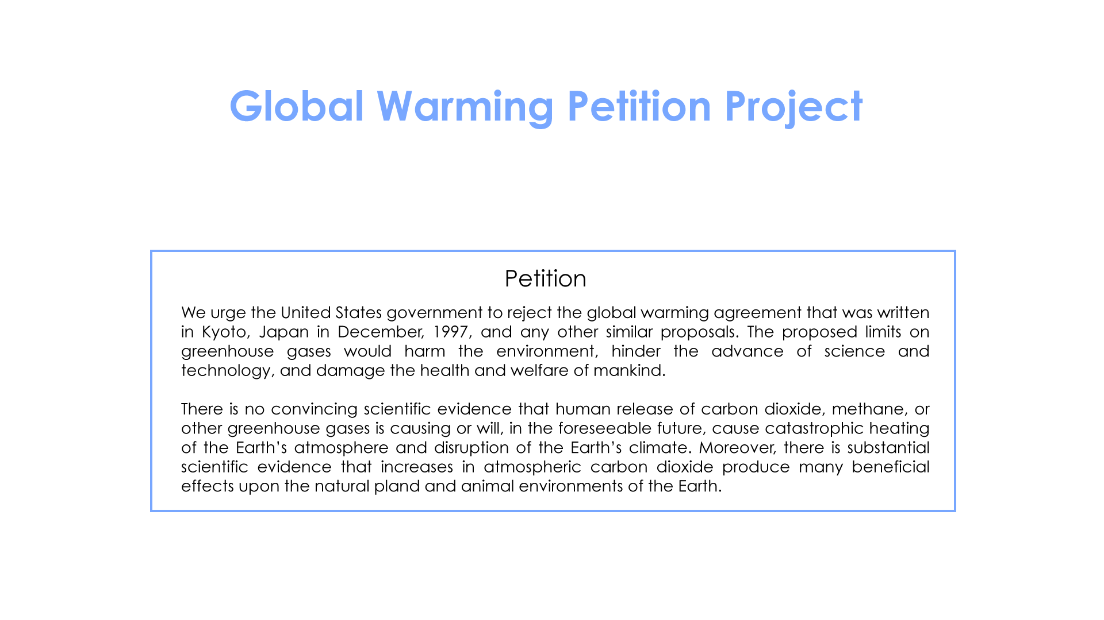

Slide 13
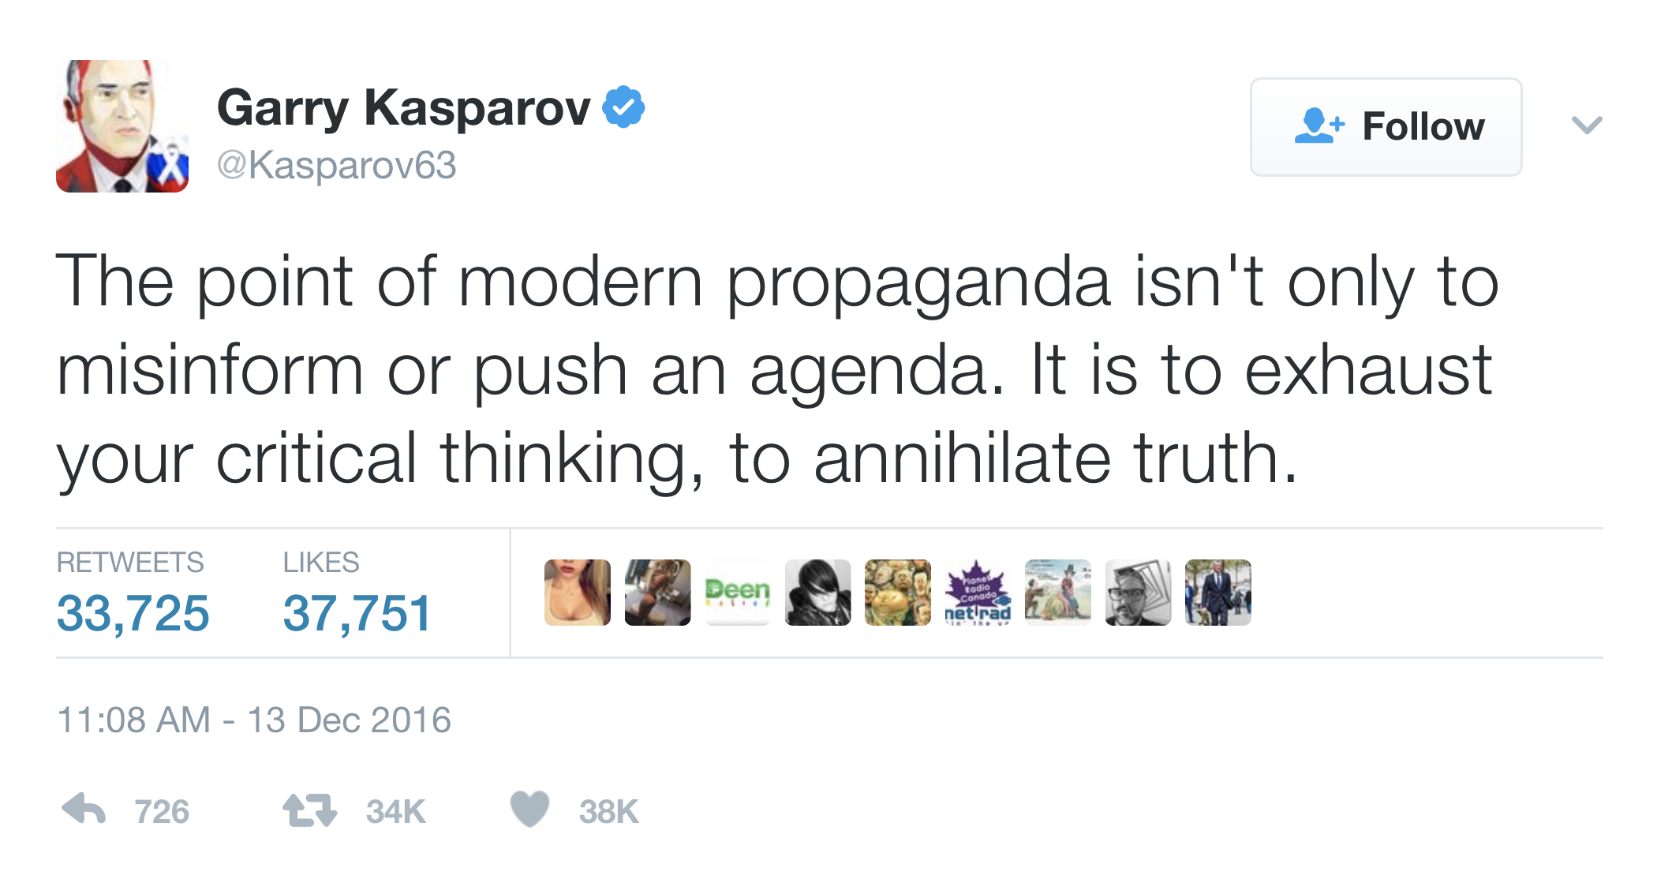

Slide 14
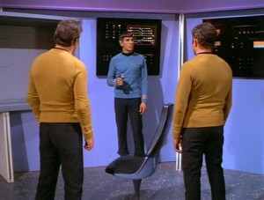

Slide 15
2
The psychology of debunking

Slide 16
Attribution 2

Slide 17
Attribution 2

Slide 18
Familiarity Backfire Effect

Slide 19
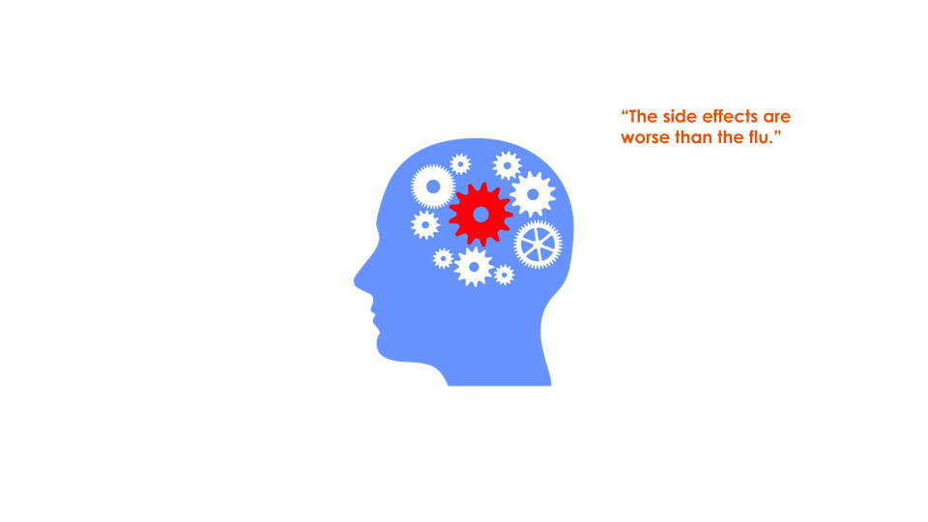
Familiarity Backfire Effect

Slide 22
Continued Influence Effect

Slide 23
Continued Influence Effect

Slide 24
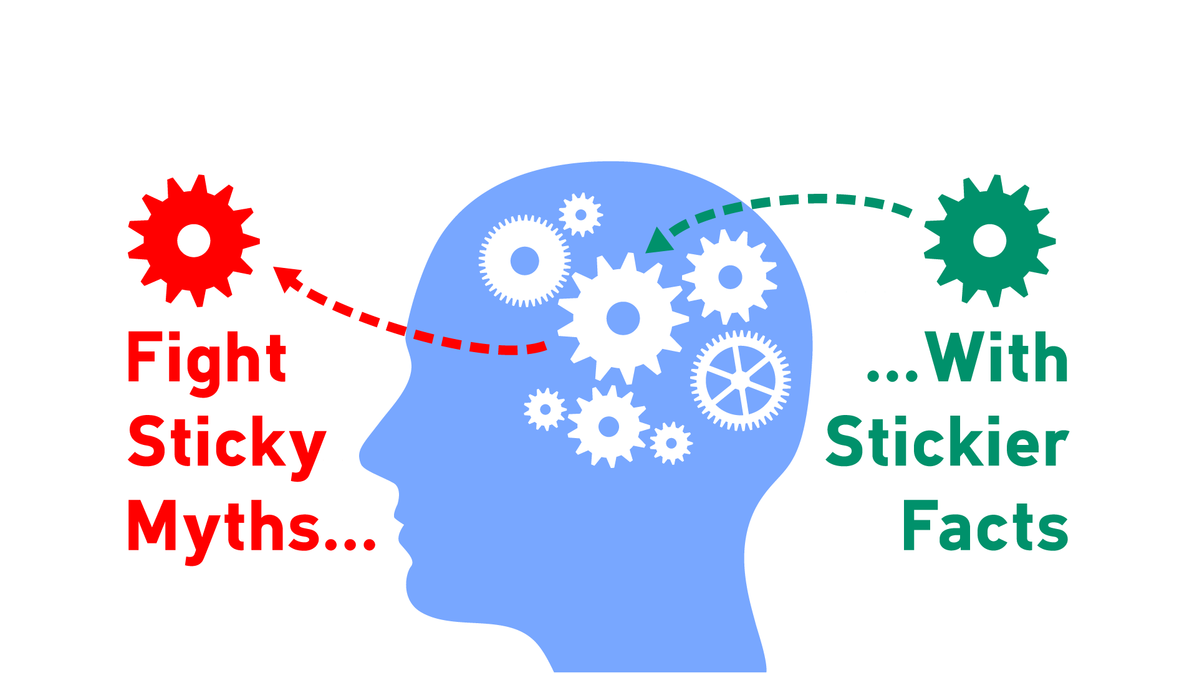

Slide 25
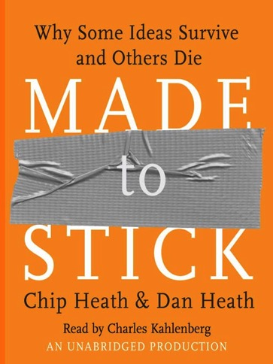
s.u.c.c.e.s.
Simple
Unexpected
Credible
Concrete
Emotional
Story

Slide 26
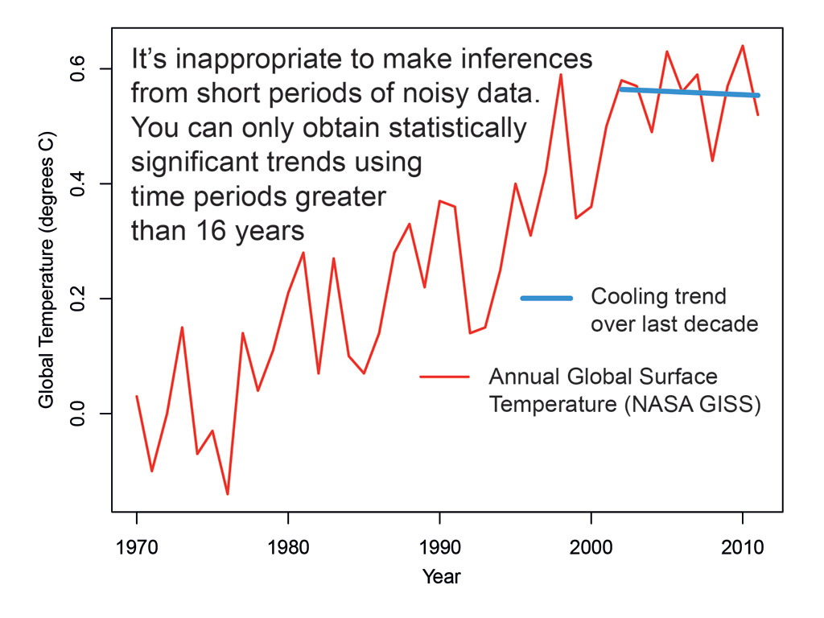
Is global warming happening?

Slide 27
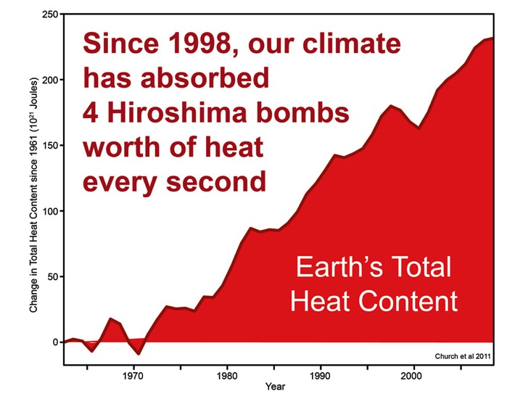

Slide 28
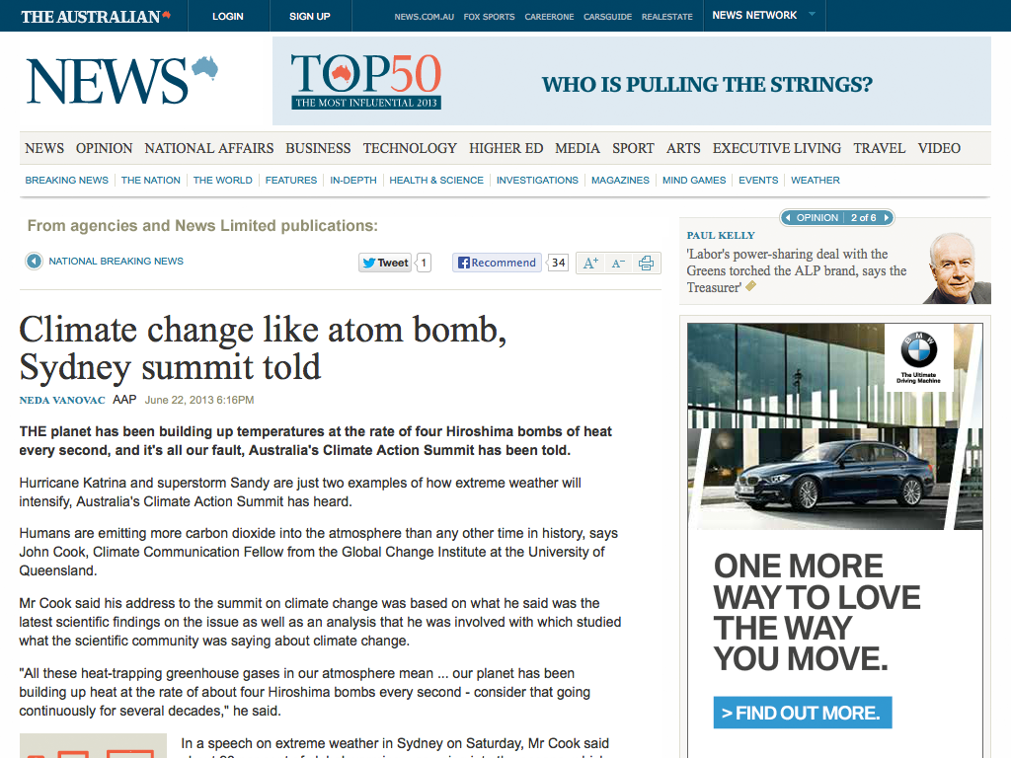

Slide 29
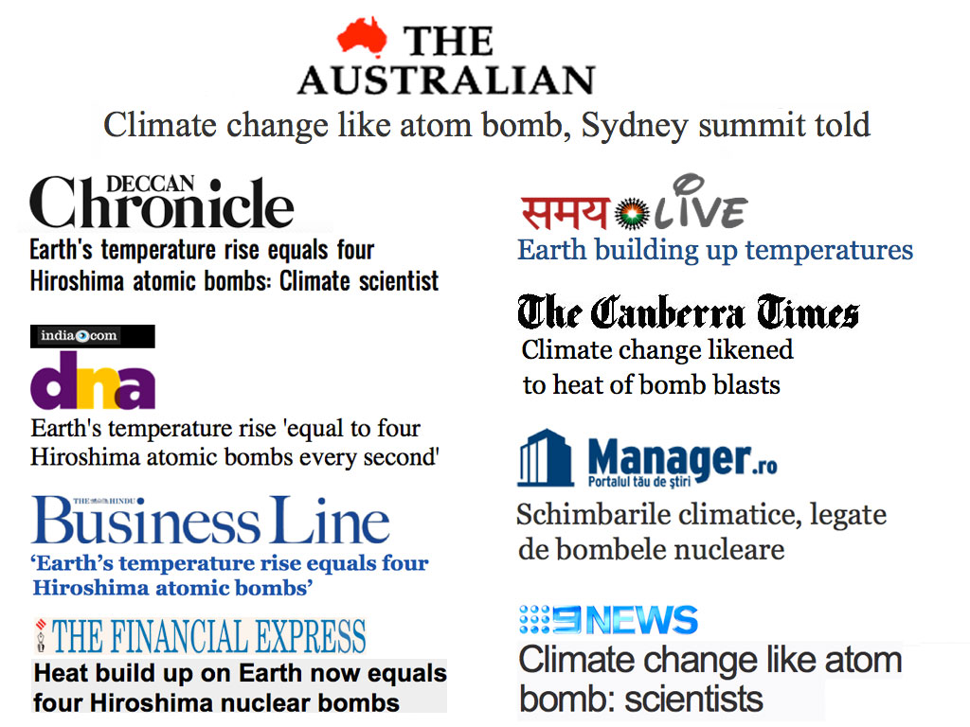

Slide 30
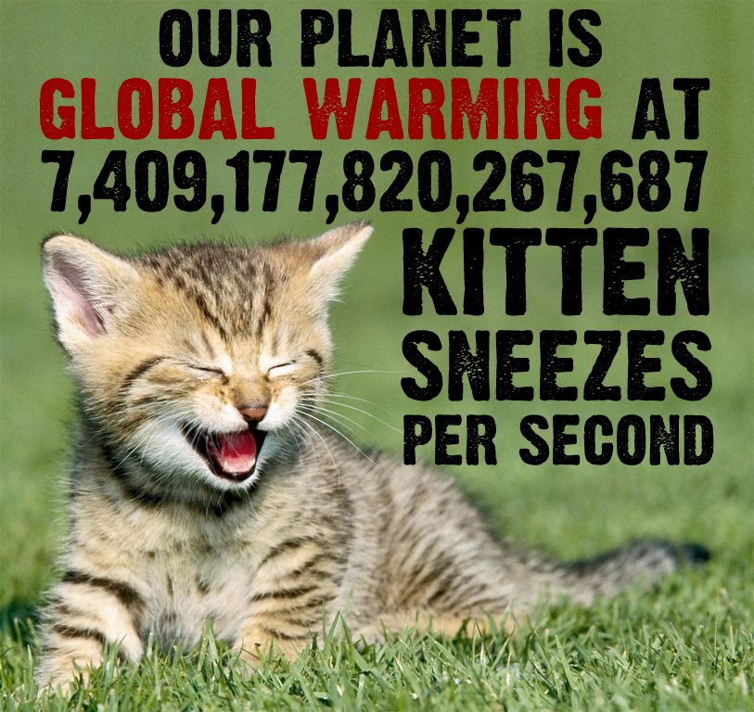

Slide 31
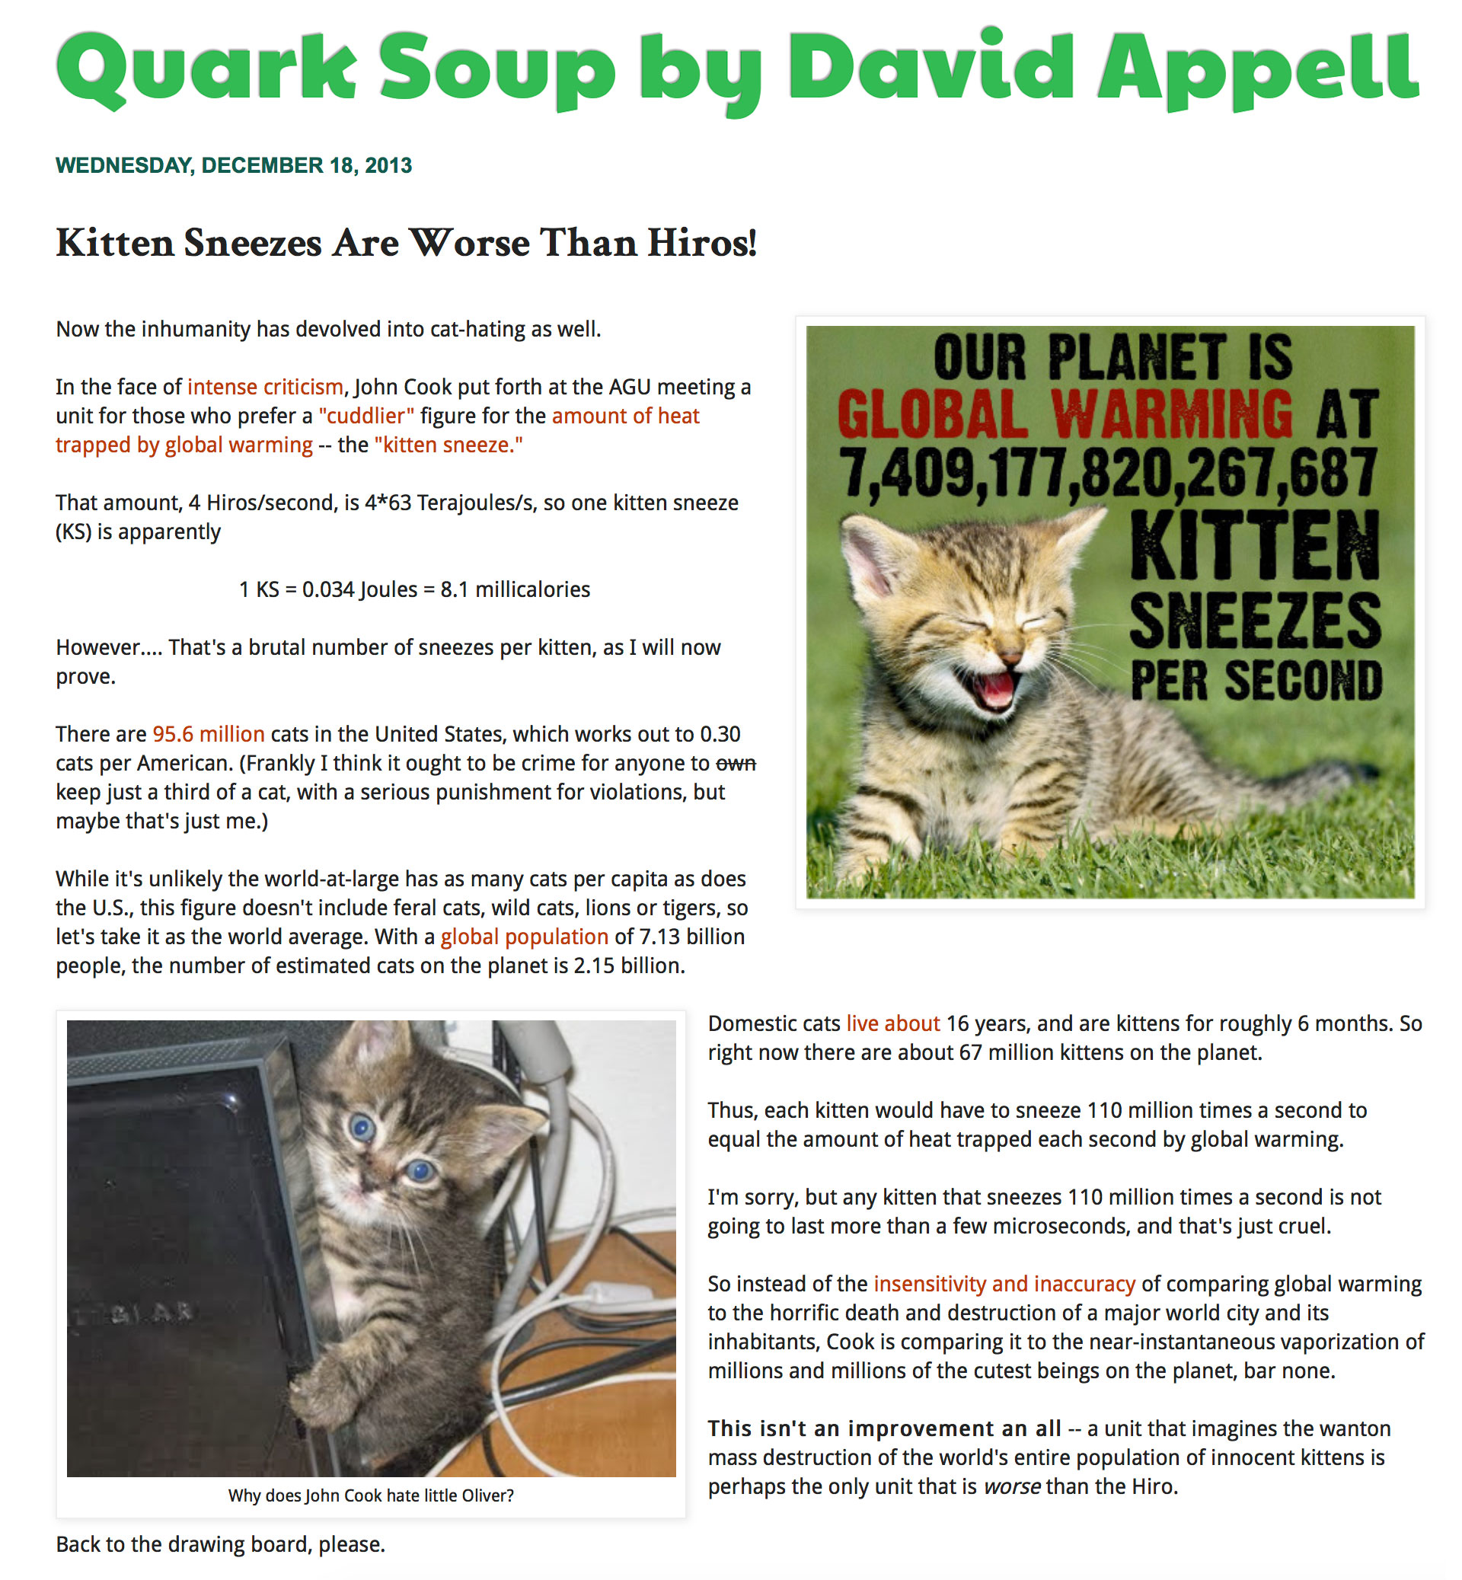

Slide 35
Inoculation theory

Slide 36
Warning Before Misinformation
… several independent investigations have concluded that the “Petition Project” is extremely misleading. For instance, many of the signatures on the petition are fake (for example, past signatories have included the long deceased Charles Darwin, members of the Spice Girls, and fictional characters from Star Wars). Also, although 31,000 may seem like a large number, it actually represents less than 0.3% of all US science graduates (a tiny fraction). Further, nearly all of the legitimate signers have no expertise in climate science at all.

Slide 37
Warning Before Misinformation
… several independent investigations have concluded that the “Petition Project” is extremely misleading. For instance, many of the signatures on the petition are fake (for example, past signatories have included the long deceased Charles Darwin, members of the Spice Girls, and fictional characters from Star Wars). Also, although 31,000 may seem like a large number, it actually represents less than 0.3% of all US science graduates (a tiny fraction). Further, nearly all of the legitimate signers have no expertise in climate science at all.

Slide 38
Warning Before Misinformation
… several independent investigations have concluded that the “Petition Project” is extremely misleading. For instance, many of the signatures on the petition are fake (for example, past signatories have included the long deceased Charles Darwin, members of the Spice Girls, and fictional characters from Star Wars). Also, although 31,000 may seem like a large number, it actually represents less than 0.3% of all US science graduates (a tiny fraction). Further, nearly all of the legitimate signers have no expertise in climate science at all.

Slide 39
Warning Before Misinformation
… several independent investigations have concluded that the “Petition Project” is extremely misleading. For instance, many of the signatures on the petition are fake (for example, past signatories have included the long deceased Charles Darwin, members of the Spice Girls, and fictional characters from Star Wars). Also, although 31,000 may seem like a large number, it actually represents less than 0.3% of all US science graduates (a tiny fraction). Further, nearly all of the legitimate signers have no expertise in climate science at all.

Slide 40
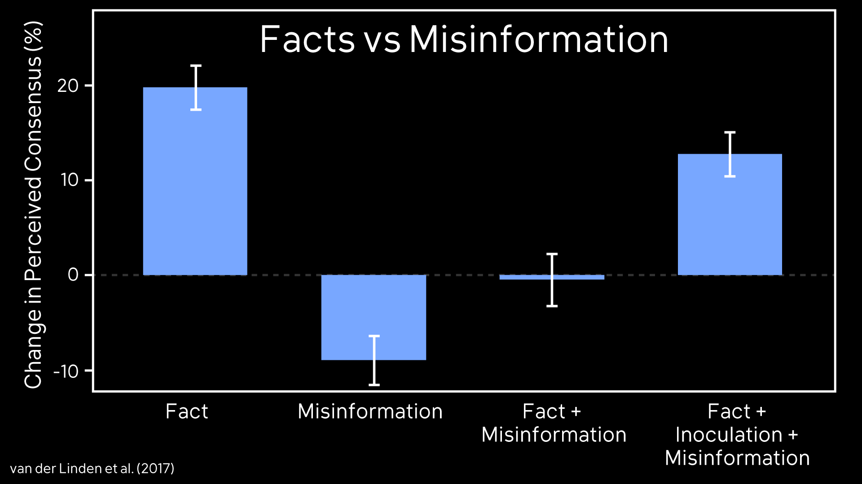

Slide 41
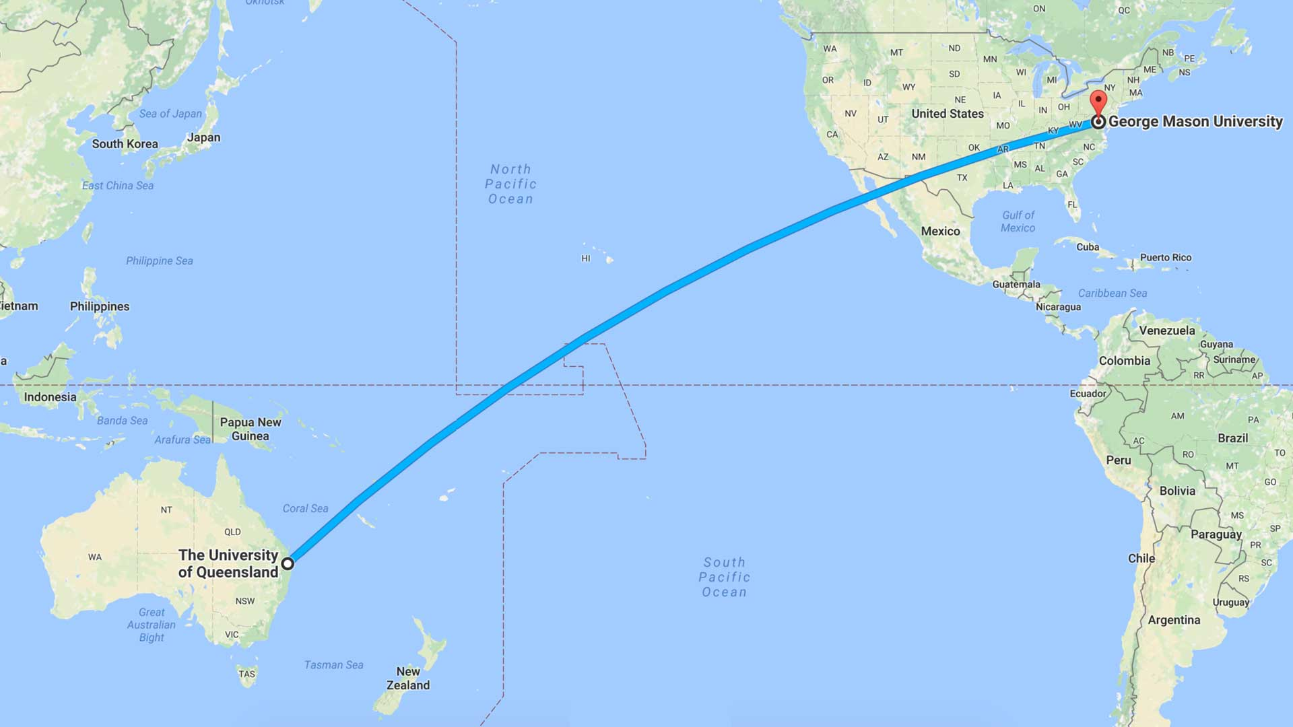

Slide 43
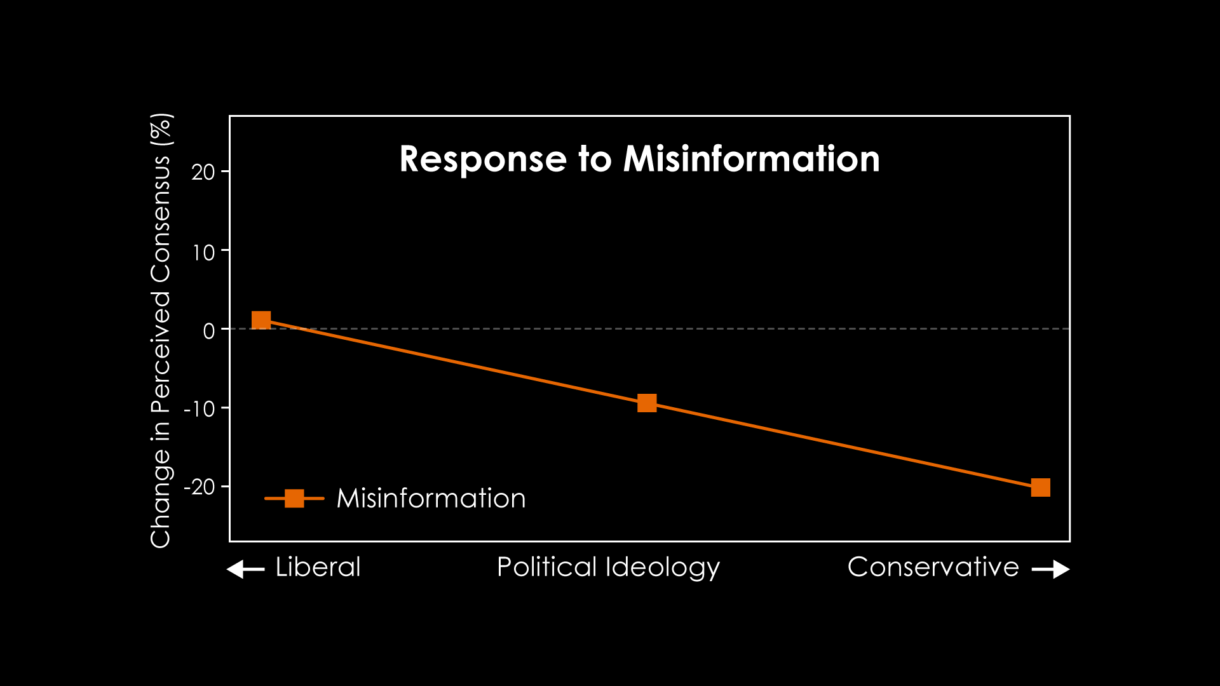

Slide 46
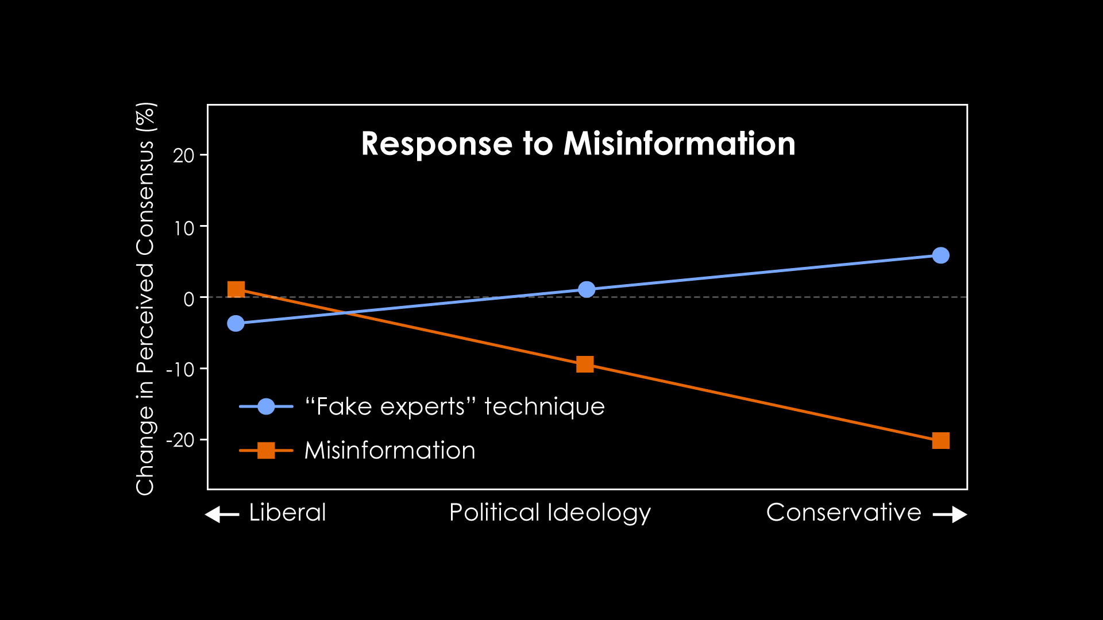

Slide 48
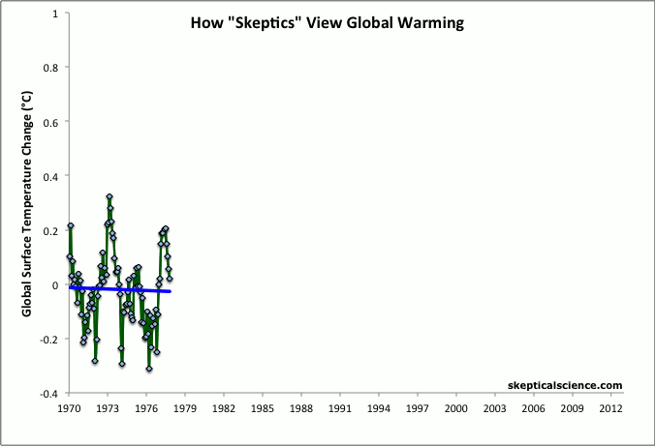

Slide 49
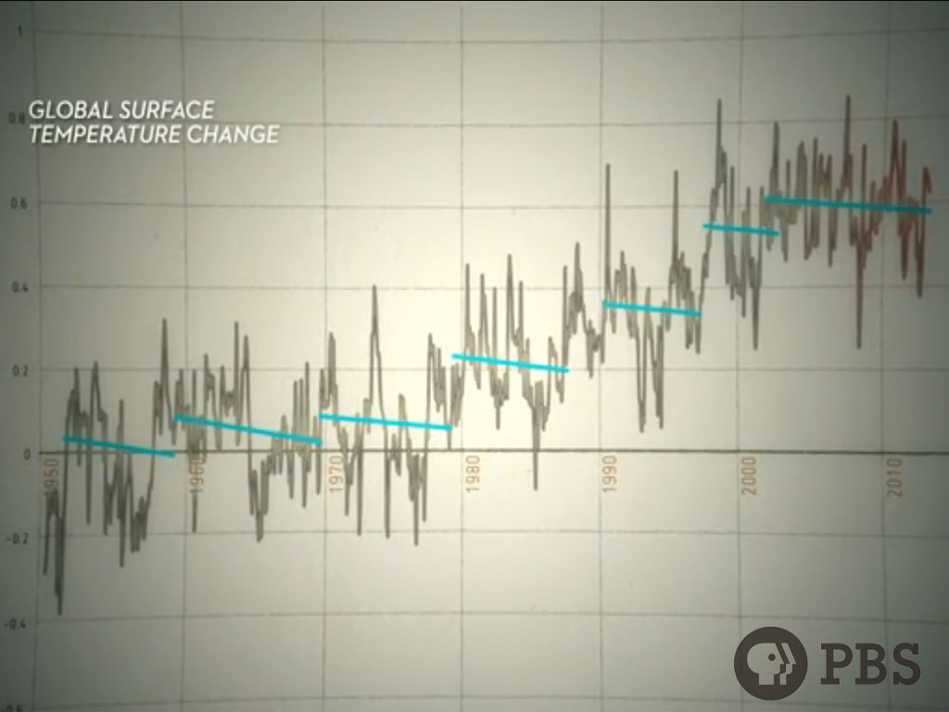

Slide 51
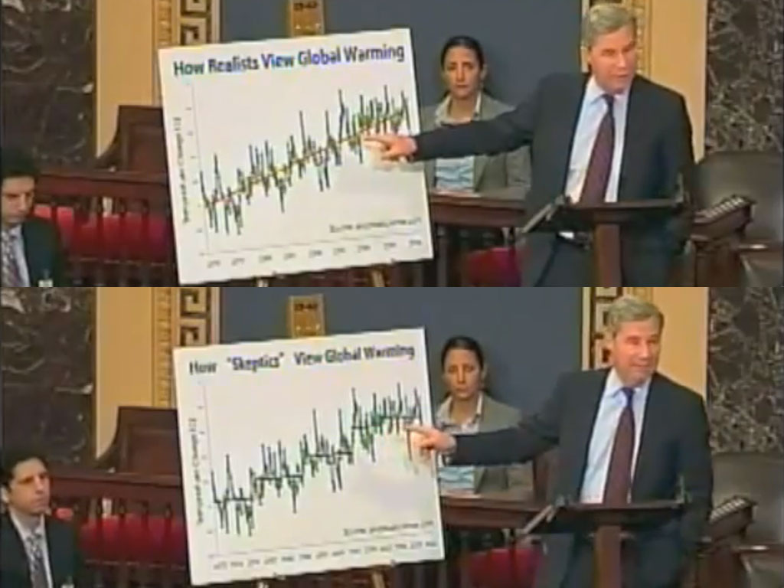

Slide 52
3
Best practices in debunking

Slide 53
Notes:
Typically, our science communication is just the green section of this slide – explaining the facts. But understanding the facts doesn’t necessarily protect people when they encounter a myth that conflicts with the facts – the two conflicting messages can cancel each other out. To help people develop immunity to misinformation, when we explain the facts, we also need to explain how the facts might get distorted. Then when people encounter a myth, they can reconcile the facts with the myth.

Slide 54
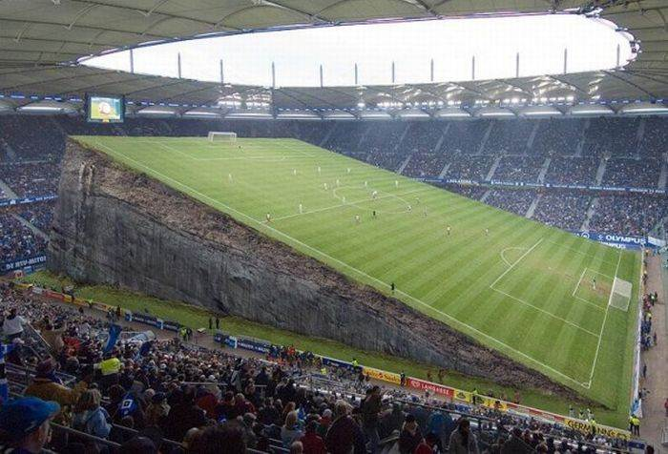
Notes:
Typically, our science communication is just the green section of this slide – explaining the facts. But understanding the facts doesn’t necessarily protect people when they encounter a myth that conflicts with the facts – the two conflicting messages can cancel each other out. To help people develop immunity to misinformation, when we explain the facts, we also need to explain how the facts might get distorted. Then when people encounter a myth, they can reconcile the facts with the myth.

Slide 55
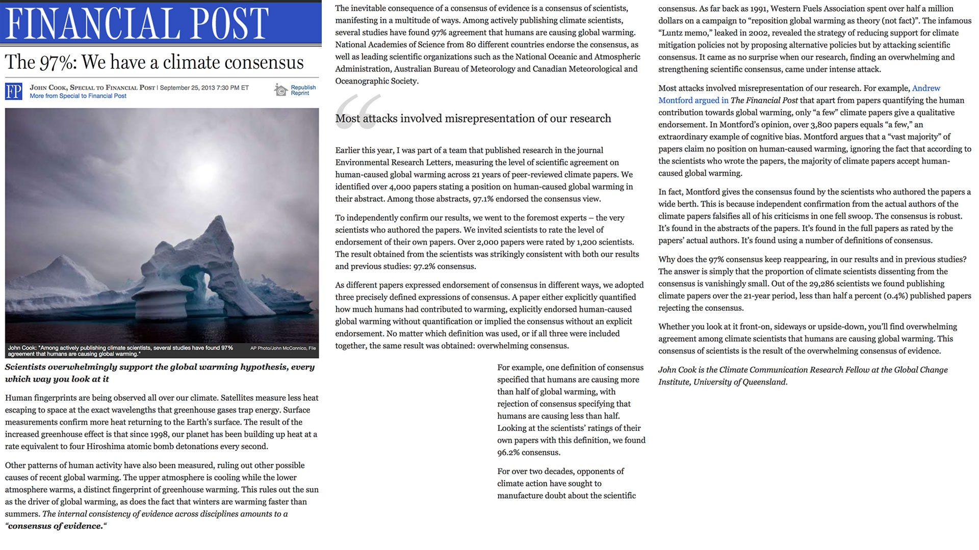

Slide 56
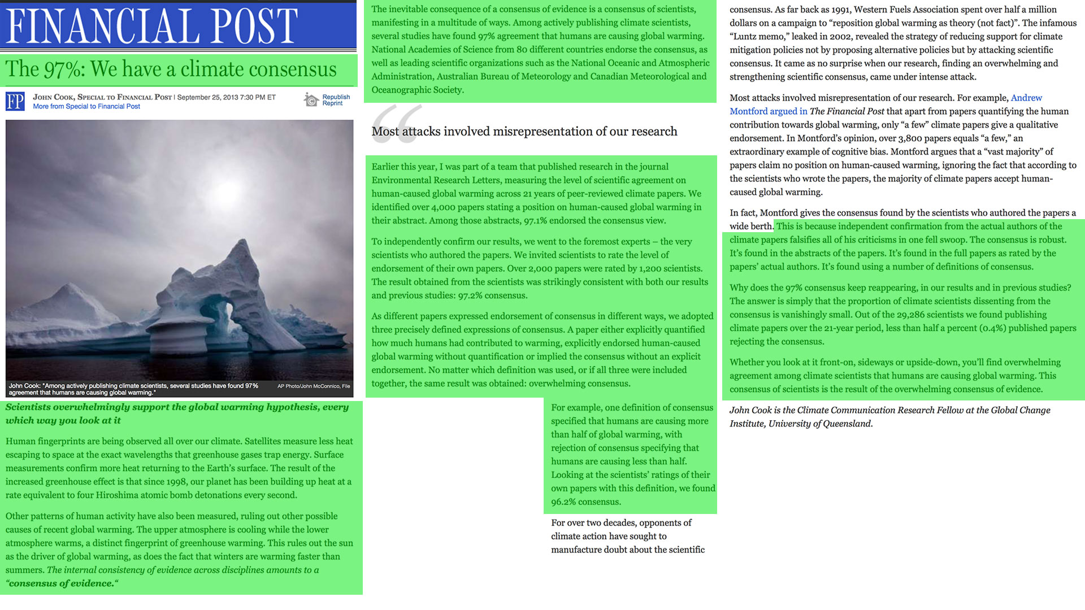

Slide 57
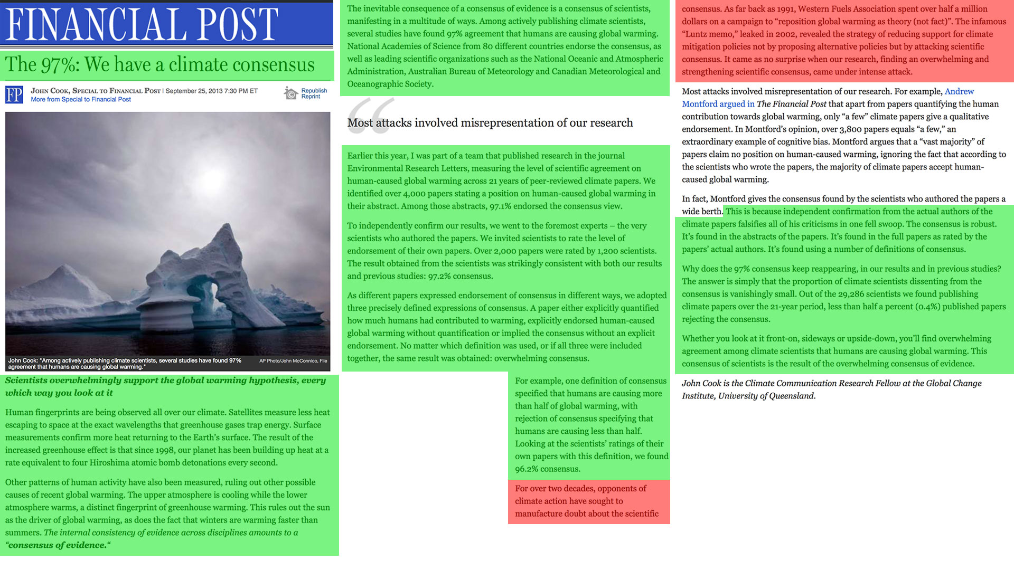

Slide 58
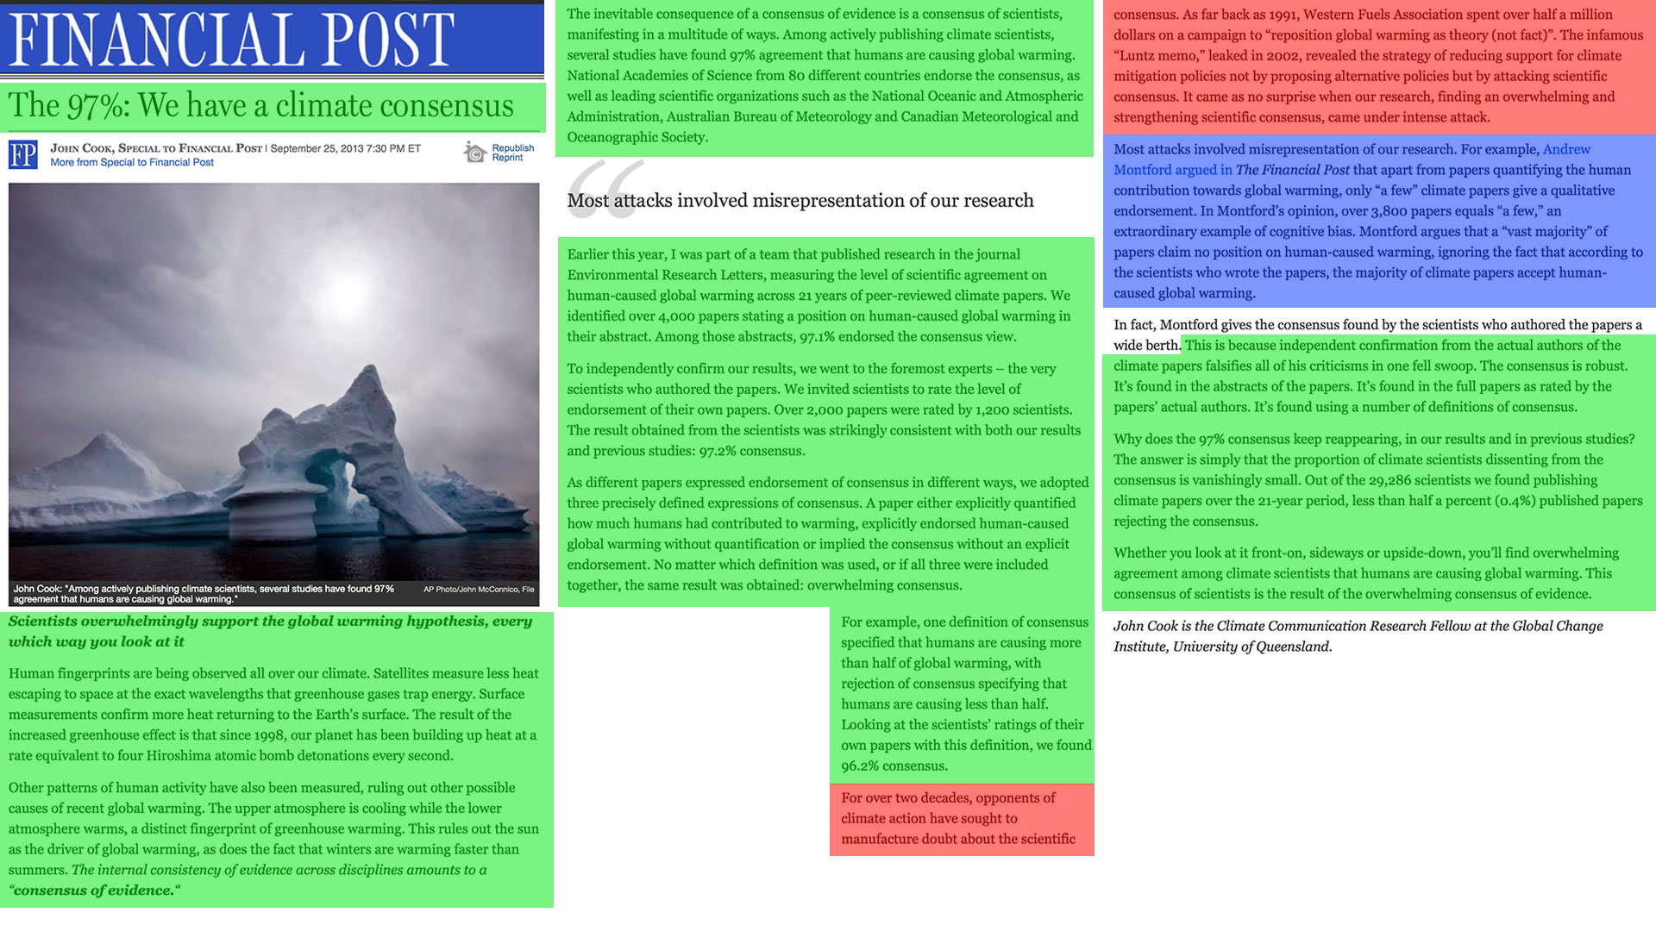

Slide 59
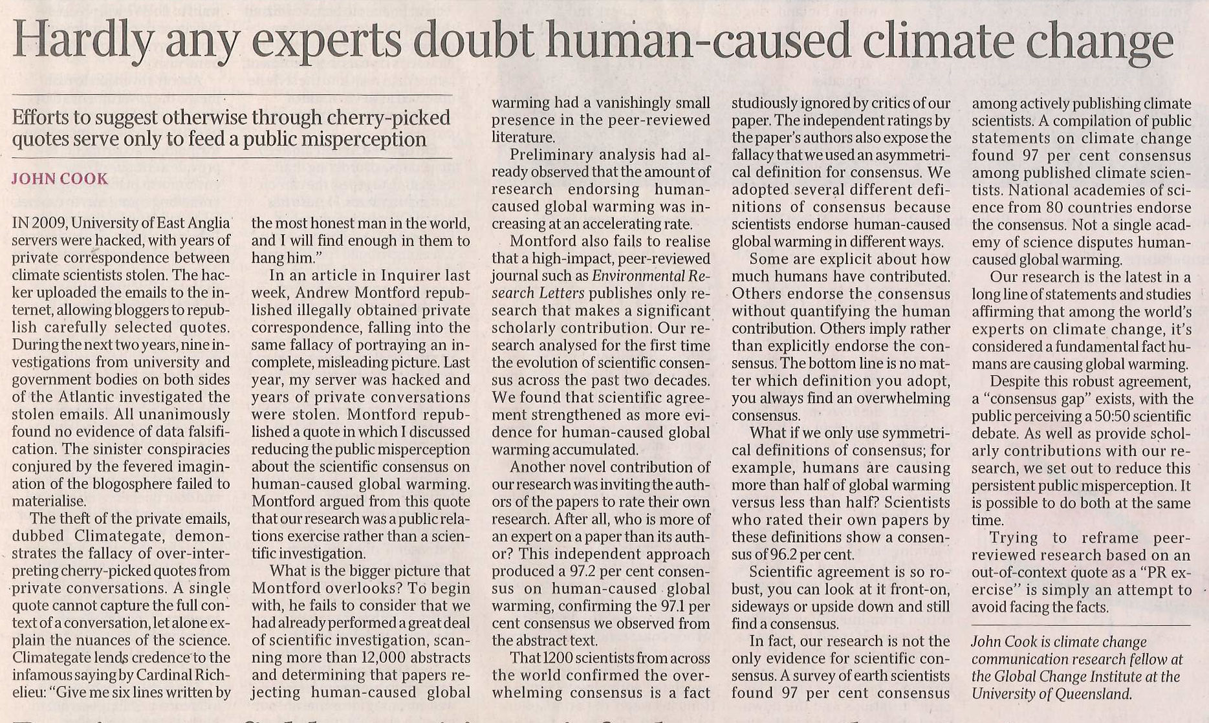

Slide 60
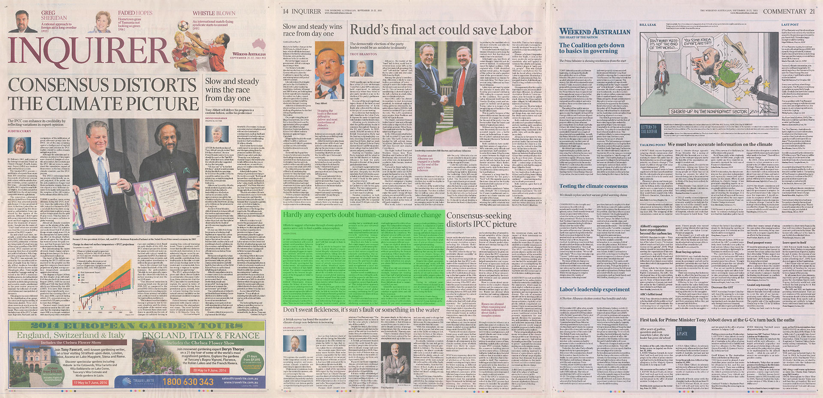

Slide 61
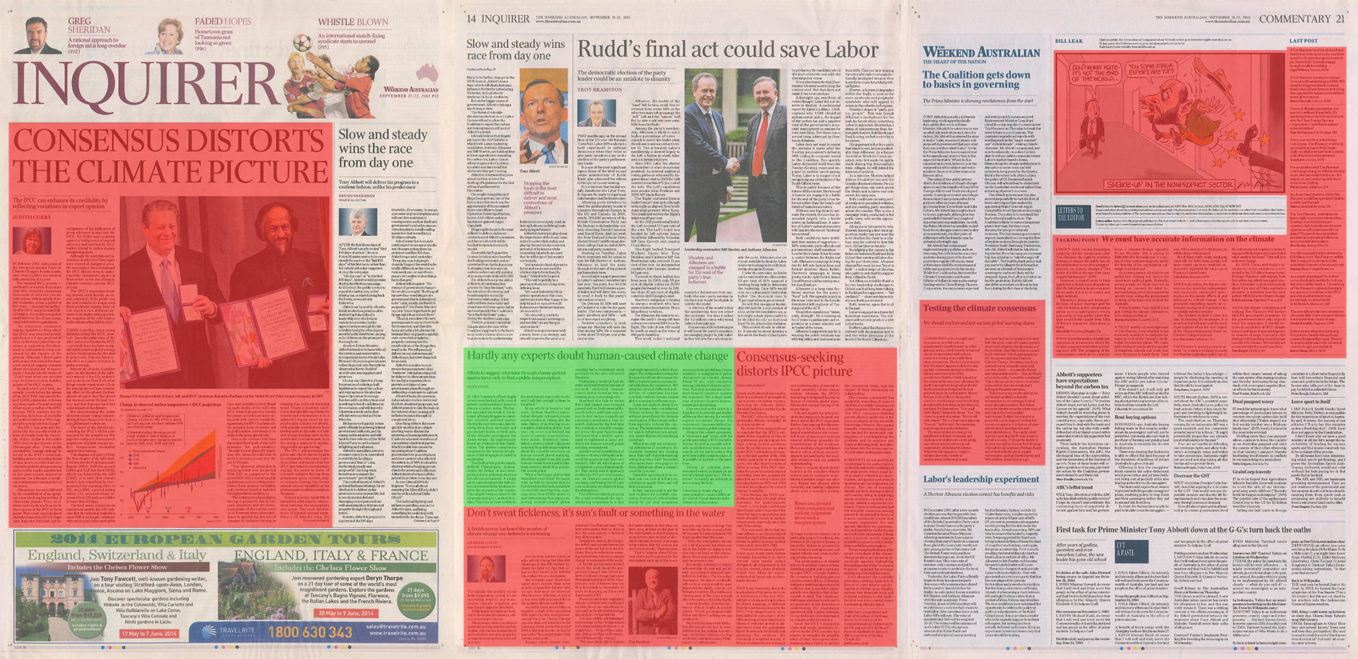

Slide 62
Notes:
Typically, our science communication is just the green section of this slide – explaining the facts. But understanding the facts doesn’t necessarily protect people when they encounter a myth that conflicts with the facts – the two conflicting messages can cancel each other out. To help people develop immunity to misinformation, when we explain the facts, we also need to explain how the facts might get distorted. Then when people encounter a myth, they can reconcile the facts with the myth.

Slide 63
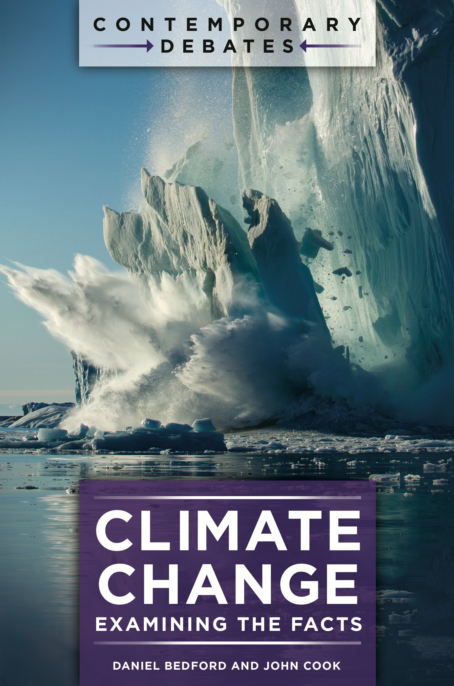

Slide 69
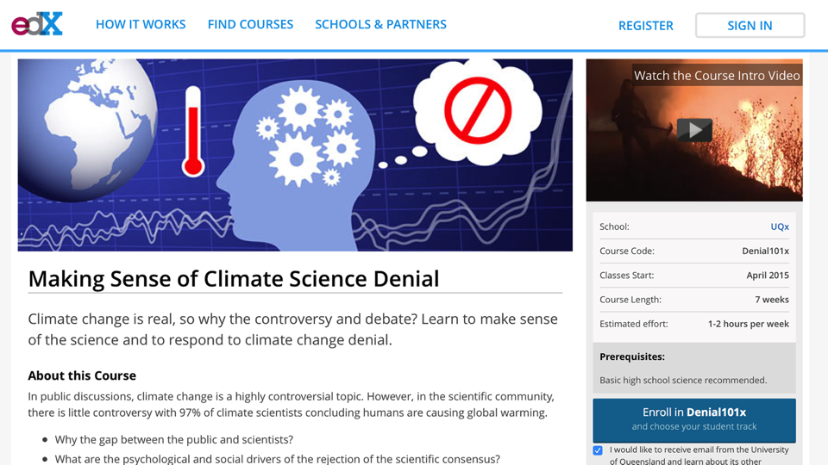
http://edx.org/understanding-climate-denial

Slide 70
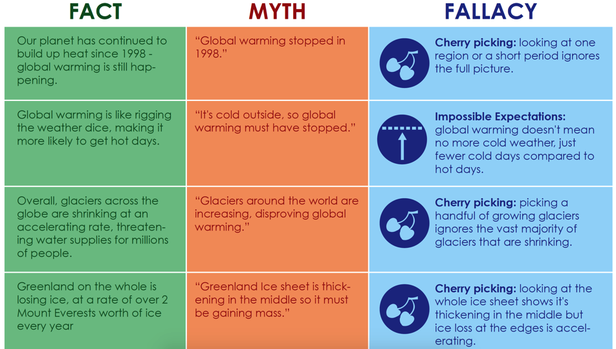
http://edx.org/understanding-climate-denial

Slide 71
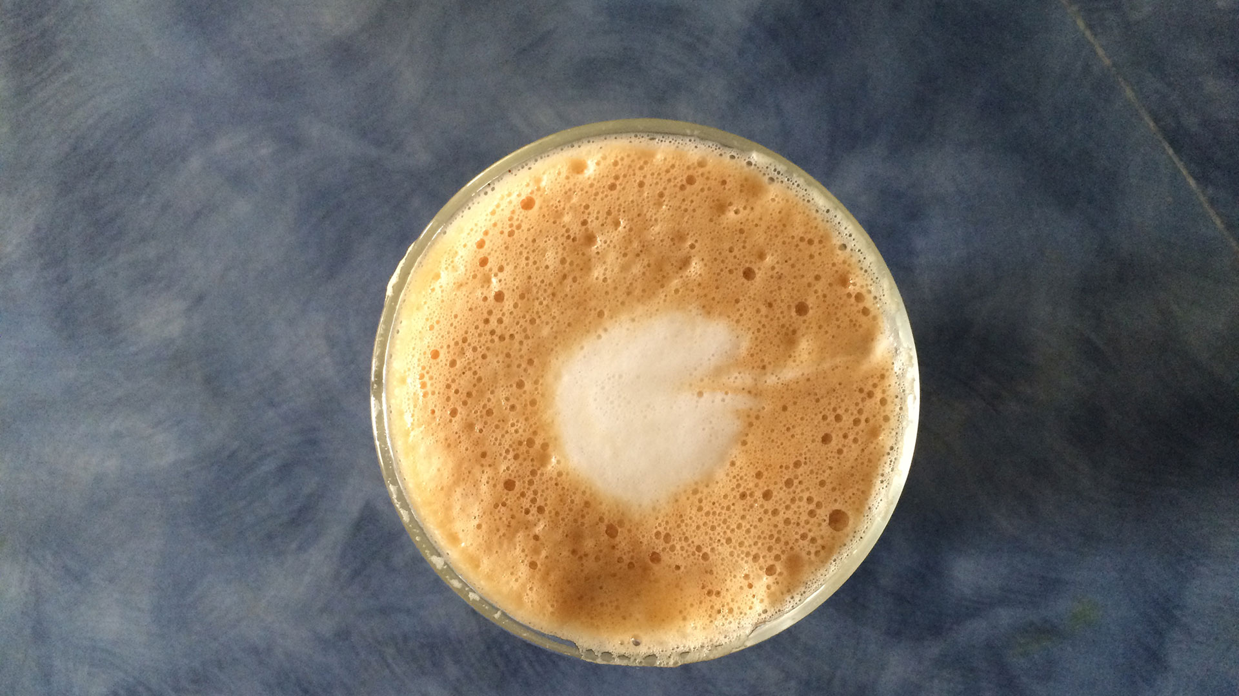
Coffee break!

Slide 74
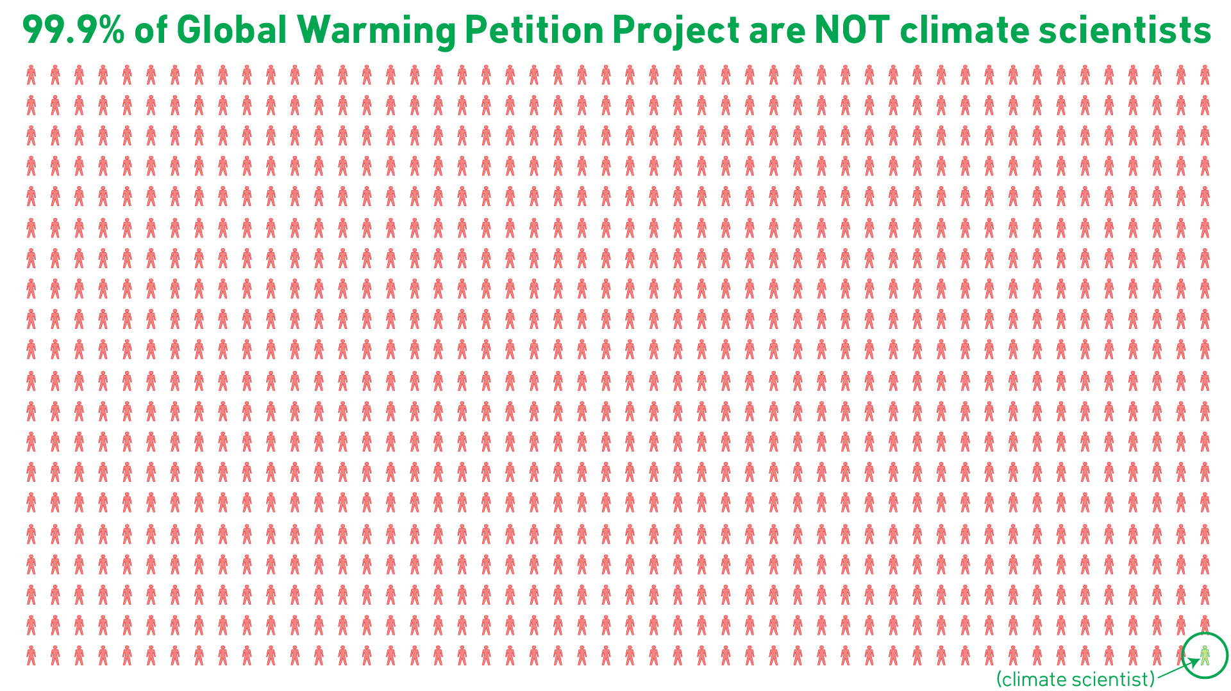

Slide 80
